Slide 1

CompTIA Security+ Certification - SYO-601 Exam Training

Slide 2


Domain 3: Implementation

Slide 3
Implementing Secure Network Designs

Slide 4

Learning Objectives
By the end of this lesson, you will be able to:
Explain secure network designs
Implement secure switching and routing
Discuss secure wireless infrastructure
Describe load balancers

Slide 5
Implement Secure Network Designs

Slide 6
Secure Network Design
A secure network design provisions the assets and services underpinning business workflows with the properties of:
Integrity
2
Confidentiality
1
3
Availability

Slide 7


Weaknesses in Network Design
Weaknesses in the network design or architecture makes it more susceptible to undetected intrusions or to catastrophic service failures. Typical weaknesses include:
Single points of failure
Overdependence on perimeter security
1
5
Lack of documentation and change control
Complex dependencies
2
4
3
Availability over
confidentiality and integrity
Refer to Cisco’s SAFE Architecture for best practice design and architecture guides.

Slide 8
Network Architecture and Business Workflows
Network architecture is designed to support business workflows.
Email mailbox server
Access
Mail transfer server

Slide 9






Network Appliances
The illustration below shows the four-layer TCP/IP model and its appliances.
00-15-5D-01-CA-4A
Mac Address
100
VLAN ID
Switch
Access Point
Data Link (Layer 2)
Address Resolution Protocol
10.1.0.192
IP Address
10.1.0.0/24
Subnet
Internet Protocol
Router
Network (Layer 3)
Firewall
Transport Control Protocol
User Datagram Protocol
Load balancer
Domain Name System
Transport (Layer 4)
HTTP
SMTP
RTP
Application
Protocol
www.515support.com Fully Qualified Domain Name
Server
FTP
DNS
Application (Layer 7)

Slide 10
Routing and Switching Protocols
A number of routing and switching protocols are used to implement forwarding.
Forwarding
Functions either as layer 2 forwarding
or layer 3 forwarding
Routing protocols Provides information on how to reach individual networks
within an internetwork
Address Resolution Protocol (ARP)
Maps MAC addresses to IP addresses
Internet Protocol (IP)
Provides the addressing mechanism for logical networks and subnets

Slide 11
Network Segmentation
A network segment allows all the hosts attached to the segment to use layer 2 forwarding to communicate freely with one another.
Network segmentation is implemented by:
Configuring virtual LANs (VLANs) on managed switches
Separating unmanaged switches
Mapping subnets to VLANs

Slide 12













Network Topology and Zones
VLAN100
(Dept. LAN)
VLAN110
(Dept. LAN)
Remote Access
VPN
Corporate
Internet Access
Extranet
Access
Access
DMZ/
Edge
DMZ/
Edge
DMZ/
Edge
A topology is a description of how a computer network is physically or logically organized.
A zone is an area of the network where the security configuration is the same for all hosts within it.
External Links
VLAN200
(Corp. Wireless)
Internet
Access
Layer 3 Switches and Security Appliance
ISP
Router
Honeynet
VLAN299
(Guest Wireless)
Core/Distribution
Access
Access
VLAN300
(Intranet)
Access
Access
Access
Access
Access
VLAN310
(App. Servers)
VLAN320
(Storage Network)
VLAN900
(Mgmt.
Workstation)
VLAN999
(Honeynet Mgmt.)

Slide 13

Types of Network Zones
Dividing a campus network or data center into zones implies that each zone has a
different security configuration. The main zones are as follows:
01
Intranet (private)
02
Extranet
03
Internet (public)

Slide 14



Demilitarized Zones (DMZs)
The most important distinction between different security zones is whether a host is internet- facing or not.
1
Internet-facing hosts are placed in one or more DMZs, which are also known as perimeter or edge networks.
Firewall
Firewall
The basic principle of a DMZ is that traffic cannot pass directly through it.
2
Enterprise LAN
DMZ
Network
Internet
If communication is required between hosts on either side of a DMZ, a host within the DMZ acts as a proxy.
3

Slide 15






Bastion Host
Bastion hosts run minimal services to reduce the attack surface on a network.
Internet
bastion hosts/ HTTP servers
exterior firewall
DMZ or perimeter network
interior firewall
Intranet
A bastion is not configured with any data that could be a security risk to the internal network, such as user account credentials.

Slide 16





Types of DMZ
DIfferent types of DMZ are used for different functions.
A DMZ hosting proxies or secure web gateways that allows employees access to web browsing and other
internet services
A DMZ for servers providing remote access to the local network via a Virtual Private Network (VPN)
A multi-tier DMZ to isolate front- end, middleware, and backend servers
1
3
5
2
4
A DMZ hosting communication servers, such as email, VoIP, and conferencing
A DMZ hosting traffic for authorized
cloud applications

Slide 17















Demilitarized Zone Topologies
Types of demilitarized zone topologies:
Screened subnet
Triple-homed firewall DMZ topology
Switch
Switch
Extranet
VLAN100
(Dept LAN)
VLAN100
(Dept LAN)
Access
Layer 3 Switches and Security Appliance
Choke Router/ Firewall
Access
DMZ/Edge
ISP
Router
Layer 3 Switches and Security Appliance
Screening Router/ Firewall
ISP
Router
Router/ Firewall
External Link
Core Distribution
DMZ/Edge
Internet
Core Distribution
External Link
Extranet
Internet

Slide 18






Screened Host
Internet access can be implemented using a dual-homed proxy or gateway server acting as a screened host.
Switch
Dual homed Gateway Server
Router/ Firewall
ISP Router
External Link
Internet
Office Network

Slide 19
Implications of IPv6
IPv6 may be enabled by default on clients and servers, and even on network appliances (routers and firewalls). The issues that arise from this are:
Risk of unmanaged configurations
IPv6-specific
attack vectors

Slide 20

Resolving Issues of IPv6
To resolve the issues that arise from default configurations of IPv6, a user can:
Map IPv6 address space to appropriate security zones
01
02
Configure IPv6 firewall rules
Configure IPv6 routing and filtering policies to mirror the equivalent IPv4 architecture
03

Slide 21



Other Secure Network Design Considerations
Other configurations that can ensure a secure network design are:
East-West Traffic
Traffic that is between servers within the data center
Zero Trust
Mitigates privilege escalation and account compromise by
threat actors

Slide 22

Implement Secure Switching and Routing

Slide 23

Man-in-the-Middle
Man-in-the-Middle (MitM) attacks are characterized by:
Covert traffic modification
2
A threat actor that intercepts and modifies communications
Spoofing responses and redirecting users to spoofed websites
1
3

Slide 24






Media Access Control (MAC) Cloning
MAC cloning or MAC address spoofing is characterized by the following:
Use of an arbitrary MAC address
Easy to change to a different value

Slide 25
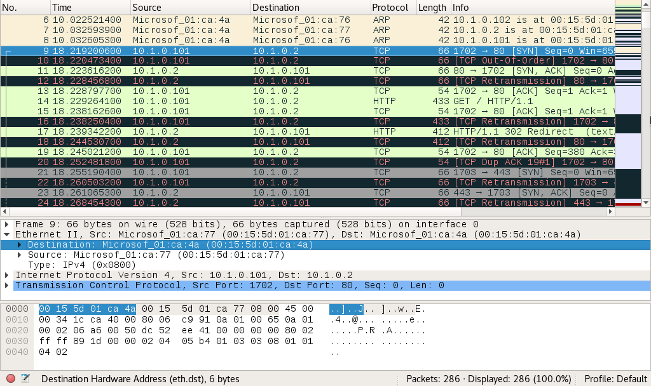
ARP Poisoning
An ARP poisoning attack broadcasts unsolicited ARP replies to poison the cache of local hosts with spoofed MAC addresses.
Packets captured during a typical ARP poisoning attack

Slide 26

MAC Flooding Attacks
While ARP poisoning is directed at hosts, MAC flooding is used to attack a switch.
The attacker’s intent is to exhaust the memory used to
store the switch's MAC address table.
01
The switch uses the MAC address table to determine which port to use to forward unicast traffic to its correct destination.
02
Overwhelming the table makes sniffing network traffic
easier for the threat actor.
03

Slide 27
Spanning Tree Protocol
Spanning Tree Protocol (STP) is a means for the bridges to organize themselves into a hierarchy and prevent forming of loops.
Root Bridge
DP
DP
RP
RP
DP
BP
Bridge A
Bridge B
Network configuration
with three switches

Slide 28
Loop Prevention Methods
Some of the other loop prevention methods are:
Broadcast storm prevention
Bridge Protocol Data Unit (BPDU) guard
Broadcast and flooded unicast gets amplified as it loops continually around network
Causes storm control if STP
has failed
Configures switches to defeat attempts to engineer a loop
Configures Portfast settings for access
ports
Disables port if STP traffic is detected

Slide 29
Port Security
Some methods of ensuring port security are:
Physical port security
Provides secure access to physical switch ports and switch hardware
Physically disconnects unused ports
Disables switch port using the management software
Dynamic Host Configuration
Protocol (DHCP) Snooping
Inspects traffic arriving on access ports
Dynamic ARP Inspection (DAI) ensures ARP packets use valid IP addresses
MAC filtering
Configures permitted MACs
Limits number of MAC changes

Slide 30
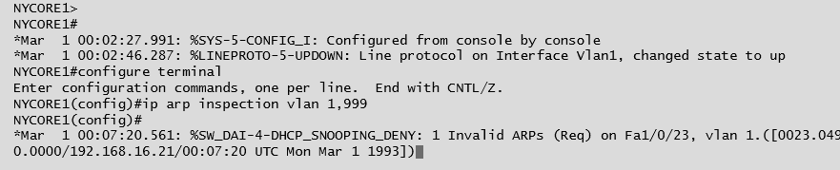
Port Security
The screenshot below shows an example of configuring an ARP inspection on a Cisco switch.

Slide 31
Network Access Control
Endpoint security is a set of security procedures and technologies designed to restrict network access at device level. The different types of network access control are:
Port-Based Network Access Control (PNAC)
Network Access Control (NAC)
1
2

Slide 32
Network Access Control: Posture Assessment
Posture assessment is the process by which host health checks are performed against a client device to verify compliance with the health policy.
Network Access Control solutions can be:
.
Agentless
Agent.-based

Slide 33


Route Security
Routing is subject to numerous vulnerabilities, including:
01
Spoofed routing information (route injection)
02
Source routing
03
Software exploits in the underlying operating system

Slide 34
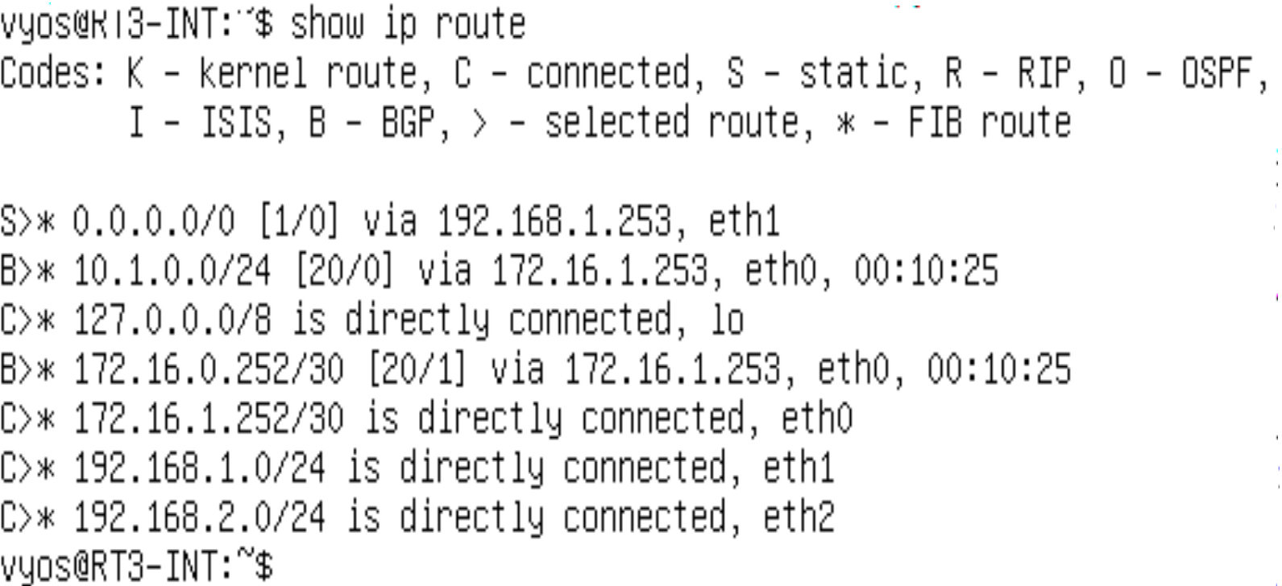
Route Security
The screenshot below shows a sample routing table listing the routes obtained from different sources.

Slide 35
Implement Secure Wireless Infrastructure

Slide 36

Wireless Network Installation Considerations
Considerations for Wireless Access Point (WAP) placement:
Service set identifier (SSID)
01
05
Adjacent Channel Interference (ACI)
Basic Service Set Identifier (BSSID)
02
04
Co-Channel Interference (CCI)
03
Frequency bands and channels

Slide 37

Wireless Network Installation Considerations
Site surveys and heat maps will help the user get an idea of:
Architectural plan
1
Channel layout
4
2
Wi-Fi analyzer
3
Heat map plots

Slide 38
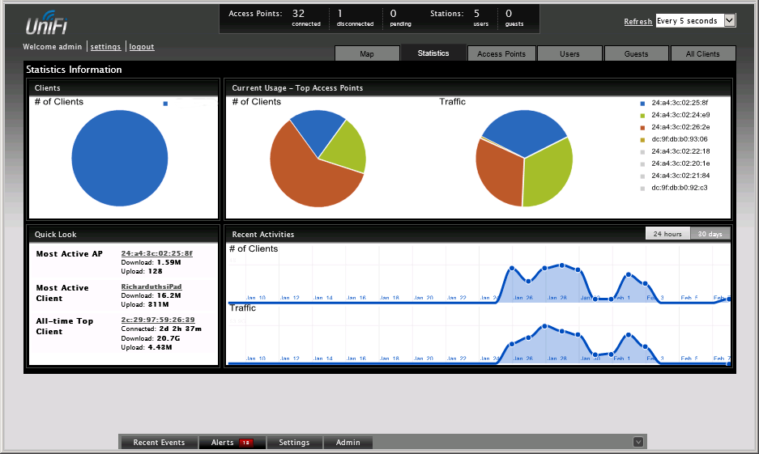
Controller and Access Point Security
While assessing controller and access point security, consider the following:
Configuration of multi-WAP WLANs
Hardware and software controllers
Fat versus thin WAPs
Physical security and management interfaces

Slide 39
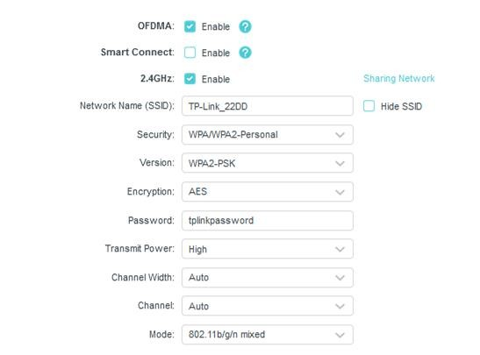
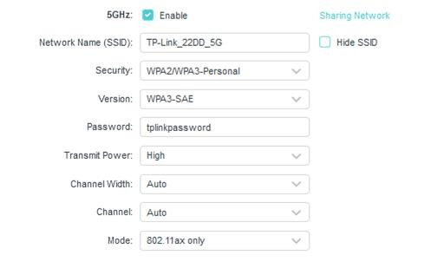
Wi-Fi Protected Access
In addition to site design, a wireless network must be configured with security settings to prevent a person within range from intercepting and reading packets passing over the wireless network.
Configuring a TP-LINK SOHO access point with wireless encryption and authentication settings

Slide 40
Wi-Fi Protected Access
The versions of wi-fi protected access can be seen below:
WPA (v1)
WPA2
WPA3
RC4 replaced with Advanced Encryption Standard (AES)
TKIP replaced with Counter Mode with
Cipher Block Chaining Message Authentication Code (CBC-MAC) Protocol
(CCMP)
Enterprise authentication
options enabled
Simultaneous Authentication of Equals (SAE)
Enhanced Open
Updated cryptography
Management protection frames
RC4 with Temporal Key
Integrity
Protocol (TKIP)

Slide 41


Wi-Fi Authentication Methods
The changes between versions of WPA are designed to prevent recovery of the hash so that it
cannot be subjected to dictionary or brute force attacks.
WPA2 Pre-Shared Key Authentication
WPA3 Personal Authentication
Passphrase used to generate a pairwise
master key (PMK)
4-way handshake
Password Authenticated Key Exchange (PAKE)
4-way handshake replaced by Simultaneous Authentication of Equals (SAE) protocol
Dragonfly handshake
PMK used to derive session keys

Slide 42

Wi-Fi Protected Setup
Wi-Fi Protected Setup (WPS) is typically used by residential consumers and
has the following features:
Pushbutton or passcode auto configuration is used for access points and clients
1
2
Passcode algorithm is vulnerable to brute-force
3
Access point may support lockout to mitigate this
4
Access point firmware must be up-to-date
5
EasyConnect and Device Provisioning Protocol (DPP) can be used

Slide 43

Open Authentication and Captive Portals
The process of open authentication uses:
An access point without authentication
(or encryption)
A Virtual Private Network (VPN) to create a secure tunnel
01
05
Secondary authentication via captive portal or splash page
Secure protocols for confidential data (HTTPS, Secure IMAP, FTPS)
02
04
03
Wi-Fi Enhanced Open

Slide 44
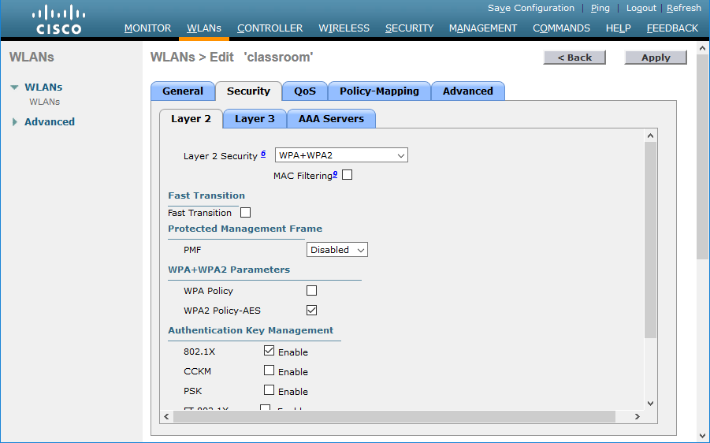
Enterprise/IEEE 802.1X Authentication
An 802.1X network is characterized by:
Extensible Authentication Protocol (EAP) over Wireless (EAPoW)
Network directory authorization via RADIUS or TACACS+
Generation of session encryption key through user credentials
Screenshot used with permission from Cisco.

Slide 45
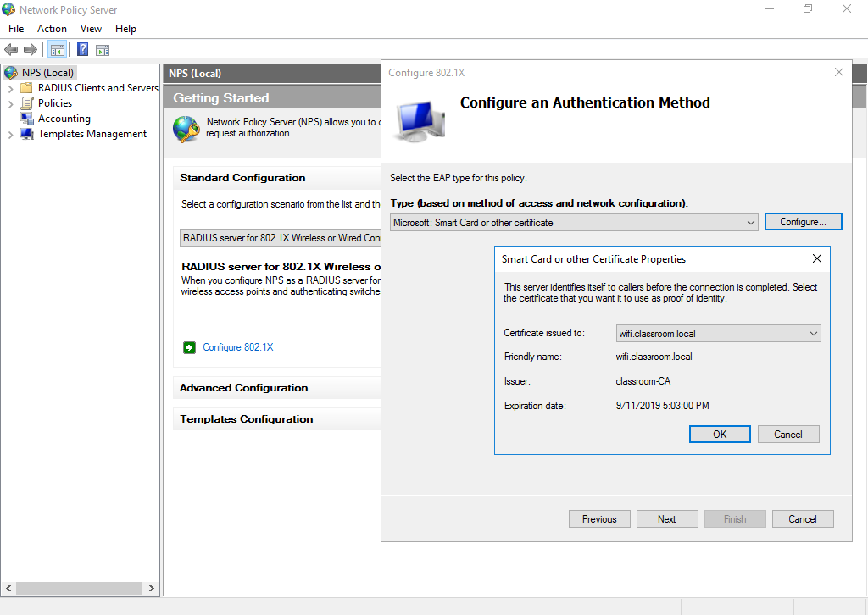
Extensible Authentication Protocol (EAP)
An EAP is designed to provide for interoperable security devices and software.
EAP-TLS
Transport Layer Security (TLS) to authenticate via device certificates or smart cards
Certificates required for both server and supplicant
Mutual authentication
Screenshot used with permission from Microsoft

Slide 46
Extensible Authentication Protocol
Other types of EAP are:
Protected EAP (PEAP)
EAP with Tunneled TLS (EAP-TTLS)
Password authentication through a TLS-protected tunnel
Only server certificate required
PEAPv0 (EAP-MSCHAPv2) or PEAPv1
(EAP-GTC) can be used
Similar to PEAP but with more flexibility on inner authentication method
EAP with Flexible Authentication via Secure Tunneling (EAP-FAST)
Cisco alternative to PEAP that can be set up without
certificate infrastructure

Slide 47


RADIUS Federation
Most implementations of EAP use RADIUS server to validate the credentials of each user.
01
Implements Federated Identity Solution
Employs mesh network for RADIUS servers operated by different institutions
02
Uses Eduroam, which is a secure, world-wide roaming access service
03

Slide 48
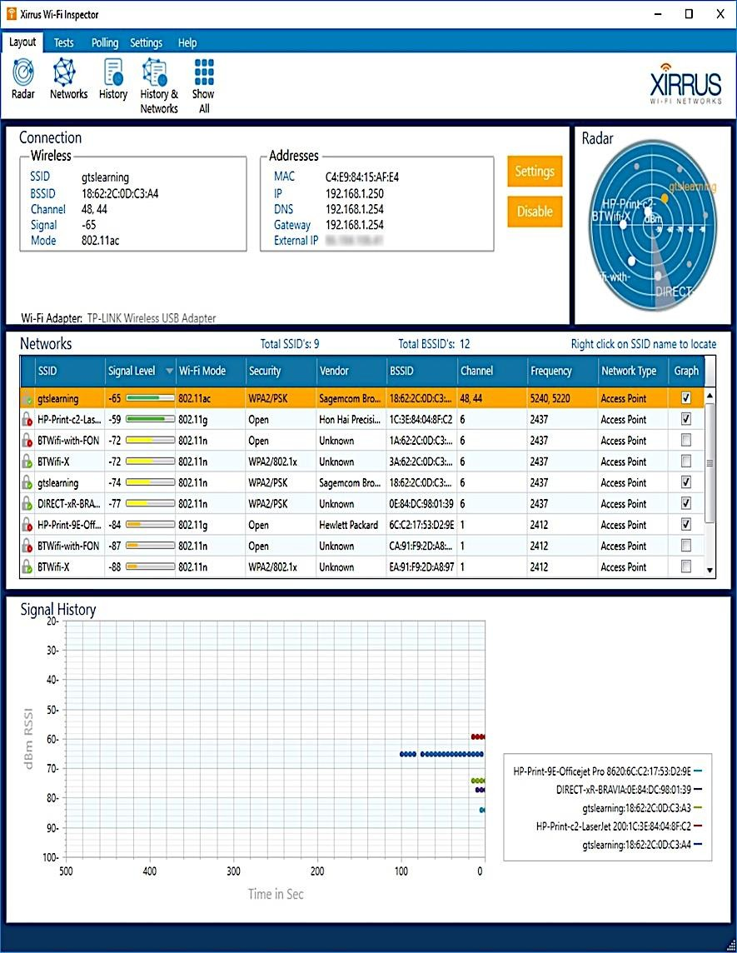
Rogue Access Points and Evil Twins
Rogue access points can be set up by malicious users and are known as evil twins.
Rogue Access Points
Evil Twin
Access points installed on the network without authorization
Masquerades as legitimate AP
Can be prevented by troubleshooting access point misconfiguration and disabling unused devices and interfaces
Uses similar SSID
Captures authentication information

Slide 49
Disassociation and Replay Attacks
These attacks target communication between a user and a wi-fi wireless access point.
Disassociation attack
Similar to deauthentication attack but only causes the station to disassociate
2
Deauthentication attack
Attacker sends spoofed deauth packet
Assists DoS and other attacks
Initialization vector (IV) attack
Generates packets to strip IV
Causes KRACK or key reinstallation
1
3
Deauthentication and dissociation attacks can be mitigated by configuring the
Management Frame Protection (MFP/802.11w).

Slide 50
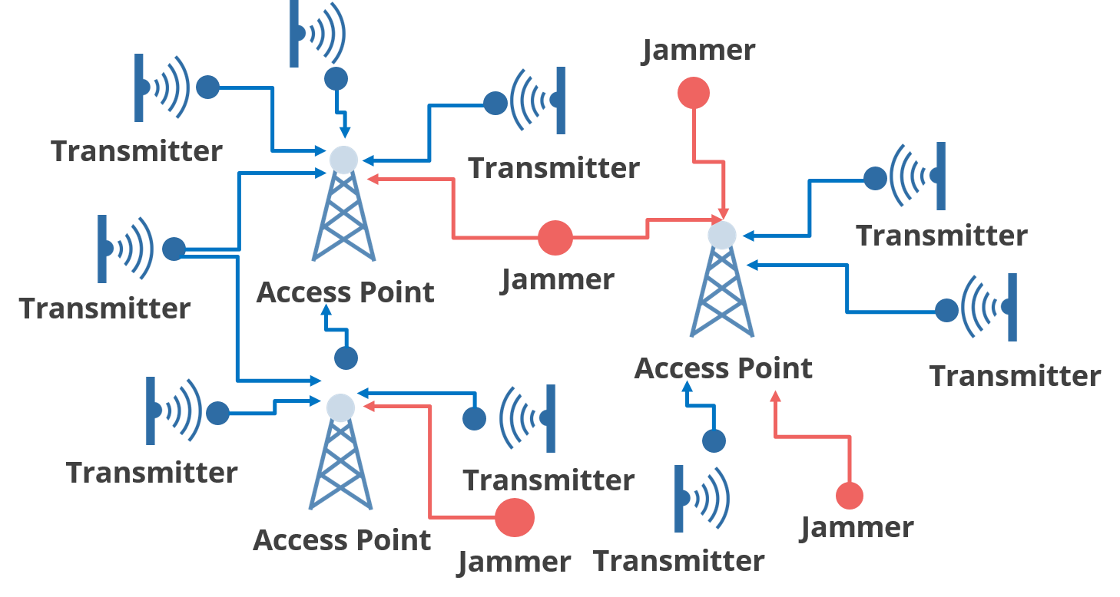


Jamming Attacks
Jamming attacks can be environmental interference from other radio sources or malicious interference.
They can promote:
Denial of service
Evil twins
Use a spectrum analyzer to locate the source of interference.

Slide 51
Implement Load Balancers

Slide 52


Distributed Denial of Service (DDoS)
A distributed denial-of-service attack occurs when numerous hacked computer systems attack a target, such as a server, website, or other network resource, causing a denial of service for users of that resource.
The rush of incoming messages, connection requests, and malformed packets causes the target system to slow down, crash, and shut down, denying service to genuine users and systems.

Slide 53
Distributed Denial of Service (DDoS)
A DDoS occurs in three steps:
Leverage bandwidth from compromised hosts or networks
Handlers form a Command and Control (C&C) network
Compromised hosts installed with bots that can run automated scripts
Co-ordinated by the C&C network as a botnet
Overwhelm with superior bandwidth (number of bots)
Consume resources with spoof session requests
(SYN flood)

Slide 54






Distributed Denial of Service (DDoS)
The image below shows an attacker machine running a client program on a victim machine.
Attacker machine
DNS Server
Targeted System

Slide 55



Types of DDoS Attacks
DDoS attacks can include amplification, application, and operational technology attacks.
Spoof victim's IP address and attempt to open connections with multiple servers
Direct SYN/ACK responses
to the victim
Application Attack
DoS against embedded systems
More vulnerable to miscrafted packets than computing hosts
Bogus DNS or NTP queries
Direct responses at victim
Queries constructed to generate large response packets
Operational technology (OT) Attack
Amplification Attack

Slide 56
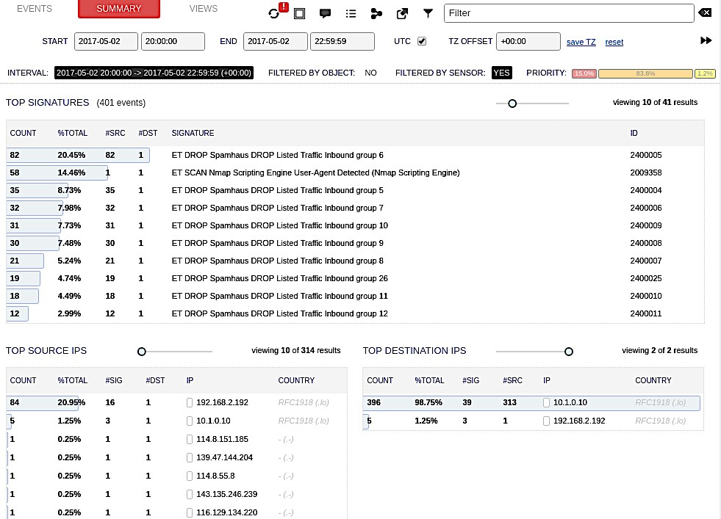

Mitigating Distributed Denial of Service Attacks
In DDoS attacks, the source addresses will be randomly spoofed or launched by bots, making it difficult to detect the source of the attack.
To mitigate this:
Drop traffic to protect other hosts in the
routing domain using:
Access Control List (ACL)
Remotely Triggered Black Hole (RTBH)
Sinkhole routing
Use Cloud DDoS mitigation services

Slide 57



Load Balancing
A load balancer distributes client requests across available farm or pool of servers.
Firewall or Intrusion Detection
Client connects to the virtual server over the Internet
10.1.0.1 Web Server
1
10.1.0.2 Web Server
10.1.0.3 Web Server
Client
203.0.113.1
Virtual Server
Load balancer
3
A persistence mechanism can keep the client connected to the same server, if it is available
2
The load balancer selects a web server instance to handle the connection and forwards the traffic

Slide 58
Types of Load Balancers
01
Layer 4 Load Balancer
Basic load balancer that makes forwarding decisions based on IP
Types of
load balancers:
Layer 7 Load Balancer
Content switch load balancer that makes forwarding decisions based on application-level data
02

Slide 59
Methods of Load Balancing
These are some of the methods used for load balancing:
Scheduling
Round robin
Fewest existing connections or best response time
Weightage
Heartbeat and health checks
Source IP Affinity and Session Persistence
Client device establishes a session with a particular node in the server farm
Continues to use that connection for
the duration of the session

Slide 60

Clustering
While load balancing distributes traffic between independent processing nodes, clustering allows multiple redundant processing nodes that share data with one another to accept connections.
Load balancing service configured as active or passive cluster
1
3
The active node responds to requests on the virtual IP
Client
VIP: 203.0.113.1
Active Redundant Load Balancer
Internal IP: 172.16.0.1
10.1.0.1
Web Server
VIP: 203.0.113.1
Virtual Server
Nodes in the cluster are connected by internal IPs and a redundancy protocol
2
10.1.0.1 Web Server
VIP: 203.0.113.1
Passive Redundant Load Balancer
Internal IP: 172.16.0.2
10.1.0.1
Web Server
Load Balancing Cluster
Web Server Farm

Slide 61
Clustering
Clustering works by:
Configuring nodes for failover
Using application clustering
Provides stateful fault tolerance
Using Virtual IP
Common Address Redundancy Protocol (CARP)

Slide 62

Quality of Service
Quality of Service (QoS) is a framework for prioritizing traffic based on its characteristics.
Packet processing on best effort and first in, first out (FIFO) basis
01
05
Denial of service and trust boundaries for traffic marking
Prioritizing traffic based on Quality of such as latency and jitter
02
04
Traffic policing
03
Traffic marking using DiffServ and 802.1p

Slide 63

Key Takeaways
A secure network design provides confidentiality, integrity, and
availability to the assets and services underpinning
business workflows.
An ARP poisoning attack broadcasts unsolicited ARP replies to poison the cache of local hosts with spoofed MAC addresses.
WPA2 pre-shared key authentication and WPA3 personal authentication are used to implement secure wireless infrastructure.
A load balancer distributes client requests across available server nodes in a farm or pool.

Slide 64
CompTIA Security+ Certification - SYO-601 Exam Training

Slide 65
Domain 3: Implementation

Slide 66
Implementing Network Security Appliances

Slide 67
Learning Objectives
By the end of this lesson, you will be able to:
Enforce firewalls Implement proxy servers
Apply network security monitoring
List the uses of SIEM

Slide 68
Implement Firewalls and Proxy Servers

Slide 69


Packet Filtering Firewalls
The earliest form of network firewall is packet filtering. This feature is available in all firewalls.
The different types are:
Access Control Lists (ACLs)
Stateless Operation

Slide 70
Access Control Lists (ACLs)
An access control list or set of rules is used to configure a packet filtering firewall (ACL).
Each law specifies a particular type of data packet and the action to be taken when a packet matches
the rule. The three different types of packet filtering rules are:
Type 02
Port filtering or security
IP filtering
Protocol ID or type
Type 01
Type 03

Slide 71
Stateless Operation
A stateless packet filtering firewall is the most basic form of firewall. It ensures:
01
The knowledge about network sessions is not saved.
02
There is no record of previously processed packets. So, each packet is evaluated independently.

Slide 72
Stateful Inspection Firewalls
A stateful inspection firewall addresses firewall problems by tracking information about the session established between two hosts or blocking malicious attempts to start a bogus session.
Stateful inspection can occur at two layers:
01
Transport Layer (OSI Layer 4)
02
Application Layer (OSI Layer 7)

Slide 73



Transport Layer (OSI Layer 4)
At the transport layer, the firewall examines the TCP three-way handshake to distinguish between new and established connections.
A legitimate TCP connection should follow a SYN > SYN/ACK > ACK sequence to establish a session, which is then tracked using sequence numbers.
Deviations from this, such as SYN without ACK or sequence number anomalies can be dropped as malicious flooding or session hijacking attempts.
The firewall can be configured to respond such attacks by blocking source IP
addresses and throttling sessions.

Slide 74
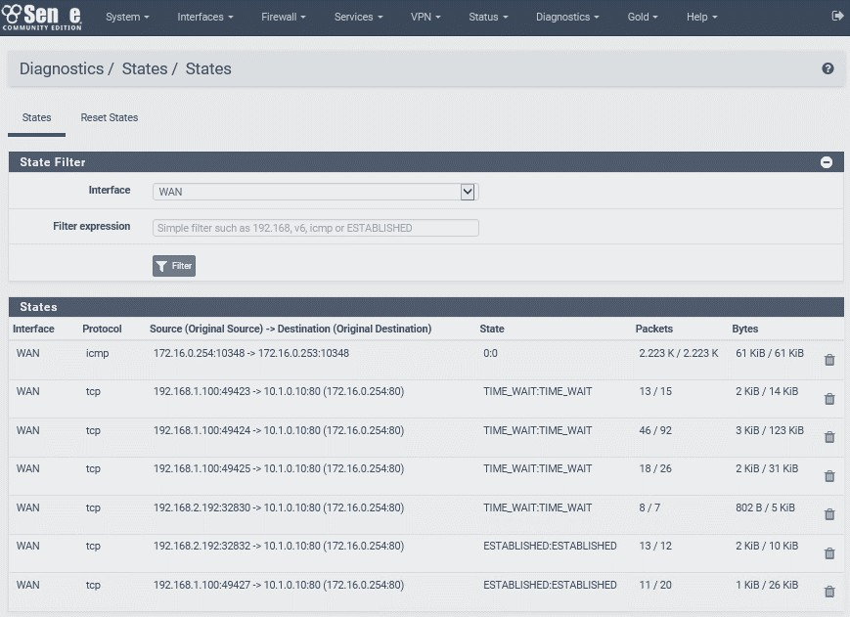
Application Layer (OSI Layer 7)
An application-aware firewall can inspect the contents of packets at the application Layer. One key feature is to verify the application protocol matches the port. For instance, if port 80 is open, the user must verify that malware isn't sending any raw TCP data over the port.

Slide 75
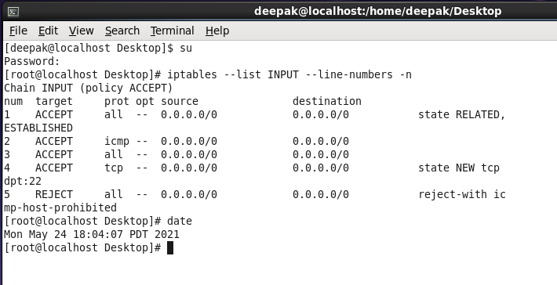
Command Line Tool
iptables is a command line utility provided by many Linux distributions. It allows administrators to edit the rules enforced by the Linux kernel firewall (linux.die.net/man/8/iptables). The command is shown below:

Slide 76
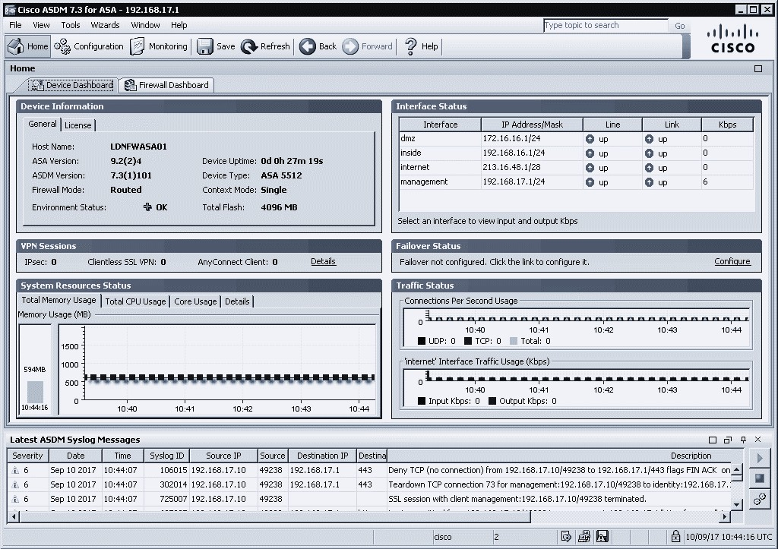
Firewall Implementation
The firewall is implemented as hardware or software to cover a given placement or to use it on the network. Types of firewalls are:
Firewall Appliances
Application-Based Firewalls

Slide 77
Firewall Appliances
A stand-alone hardware firewall is known as an appliance firewall. It is used to track traffic entering and exiting a network region. There are two ways to deploy a firewall appliance:
01
Performing subnet routing using Routed (layer 3) firewall
02
Examining traffic between two nodes, such as a router and a switch using Layer 2 (bridged) firewall

Slide 78



Application-Based Firewalls
Firewalls can also be installed as applications on any computing platform. Application-based firewalls come in a variety of shapes and sizes. They include:
Host-based firewall (or personal firewall): A software program that runs on a single host and protects only that host.
Application firewall: A software that runs on a server and is configured to secure a single application.
Network Operating System (NOS) firewall: A software-based firewall that runs on a network server operating system like Windows or Linux.

Slide 79
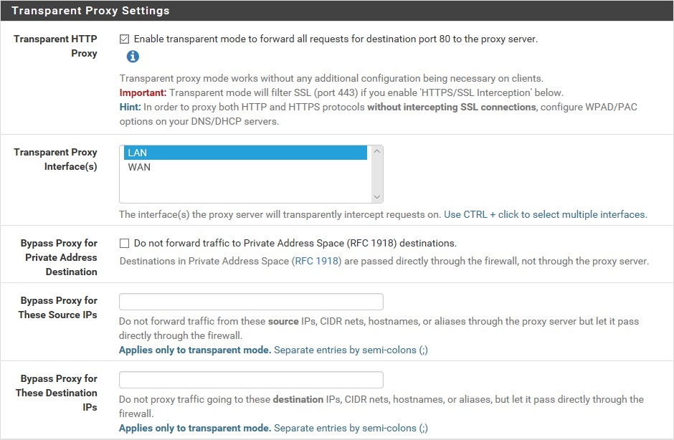
Proxies and Gateways
A proxy is more likely to be used with a firewall that conducts application layer filtering. A proxy server operates on a store-and-forward model.
The screenshot shows the configuration of transparent proxy settings for the Squid proxy server running on pfSense.

Slide 80

Forward Proxy Server
Proxy opens connections with external servers on behalf of internal clients that includes:
Application-specific filters
Non-transparent and transparent proxies
User authentication

Slide 81



Reverse Proxy Server
Reverse Proxy Servers (RPS) handle protocol-specific inbound traffic.
Proxy opens connections with internal servers on behalf of external clients.

Slide 82






Access Control Lists
Firewall Access Control Lists (ACLs) are configured using the least-access principle and the rules are processed in a top to bottom order. If any of the rules do not match, it implicitly denies them and arranges all rules in tuples order.
ALC
Permit/Denied
Internet
Permitted
Denied
Sales
S0/0/0
Marketing
Denied
Fa1/0
Denied
Fa1/0
R1
Denied
172.16.40.0/24
172.16.60.0/24
172.16.50.0/24
Finance

Slide 83
Access Control Lists
Several additional fundamental principles include the following:
Prevent requests from internal or private IP addresses from being processed
01
Follow standard security procedures for securing the hardware on which the firewall is running.
Deny incoming requests from protocols that are intended to operate at the local network level, such as ICMP, DHCP, or routing protocol traffic
02
04
03
Confirm the configuration is secure
through penetration testing

Slide 84





Network Address Translation
NAT stands for Network Address Translation and it was designed to free up IP addresses for hosts who needed Internet access. The process is as shown below:
index.htm from: 77.72.206.10:80
Reply to:
217.45.253.5:60101
10.0.0.101
Connect 100.0,101:1024
to comptia.org/index.htm
77,72.206.10:80
Open corrections for: 217.45.2533.60101
217.45.2533.60103
10.0.0.102
Connect 100.0,103:1024
to comptia.org/index.htm 77,72.206.10:80
NAPT firewall Inside
Local: 10.0.0.1
Inside Global: 217.45.253.5
Internet Web Server Outside Global: 77.72 206.10
10.0.0.103
help.htm from: 77.72.206.10:80
Reply to: 217.45.253.5:60103

Slide 85
Network Address Translation
Types of NAT are:
Source NAT
Destination NAT or port forwarding
Static and dynamic NAT
Overloaded NAT or Network Address Port Translation (NAPT) or Port Address Translation (PAT)
Advertise a resource using a global IP address but forward it to a local IP address
Forwards specific ports only

Slide 86


Virtual Firewalls
Virtual firewalls are frequently used in data centers and cloud computing environments.
The three distinct methods for implementing a virtual firewall are:
Hypervisor-based: Indicates that the hypervisor or cloud provisioning tool includes filtering functionality
Virtual appliance: Refers to a virtual machine deployed on the cloud
Multiple context: Refers to the simultaneous operation of multiple virtual firewall instances on a hardware firewall appliance
Virtual firewalls implement east-west security design and micro segmentation.

Slide 87

Open-Source vs. Proprietary Firewalls
The ability to inspect source code will be required for environments with a high level of security that cannot rely on implicit trust when selecting vendors.
The underlying firewall code can be developed as:
Primarily proprietary
2
Completely proprietary
1
3
Completely open-source

Slide 88
Implement Network Security Monitoring

Slide 89
Network-Based Intrusion Detection Systems
Network-Based Intrusion Detection Systems is an Intrusion Detection System (IDS) that performs real-time analysis of network traffic, system and application logs, and other data using software tools like:
Detection engine to perform real-time analysis of indicators
2
Network sensors to capture
traffic
Logs for passive logging or alerting
1
3

Slide 90



Network-Based Intrusion Detection Systems
A NIDS is used to identify and log hosts and applications. In addition to, attack signatures, attempted IP spoofing, vulnerability scanners, worms, backdoor applications, malformed packets or sessions, and policy violations. The process is shown below:
The Internet
Firewall
NIPS
Trusted network

Slide 91
TAPs and Port Mirrors
There are three primary methods for connecting a sensor to an appropriate network node:
SPAN or Mirror Port
It refers to the sensor connected to a specially configured switch port that receives copies of frames addressed to specific access ports.
Passive Test Access Point
Active TAP
A box that contains ports for incoming and outgoing network cabling, as well as an inductor or optical splitter that physically copies the signal from the cabling to a monitor port.
A powered device that regenerates signals copper and fibre variants are available), which may be necessary in certain circumstances.

Slide 92

Network-Based Intrusion Prevention Systems
Preventive methods used to respond network threats include:
Intrusion Prevention System (IPS)
Active response to threats
Anti-virus scanning or content filtering
Inline placement to avoid risk of failure

Slide 93
Signature-Based Detection
An analysis engine is a component of an IDS that scans and interprets the traffic captured by the sensor in order to detect suspicious activity.
A signature-based detection engine performs the following:
Matches attack patterns or signature
Maintains a database of known attack signatures
Updates the detection software on a regular basis

Slide 94
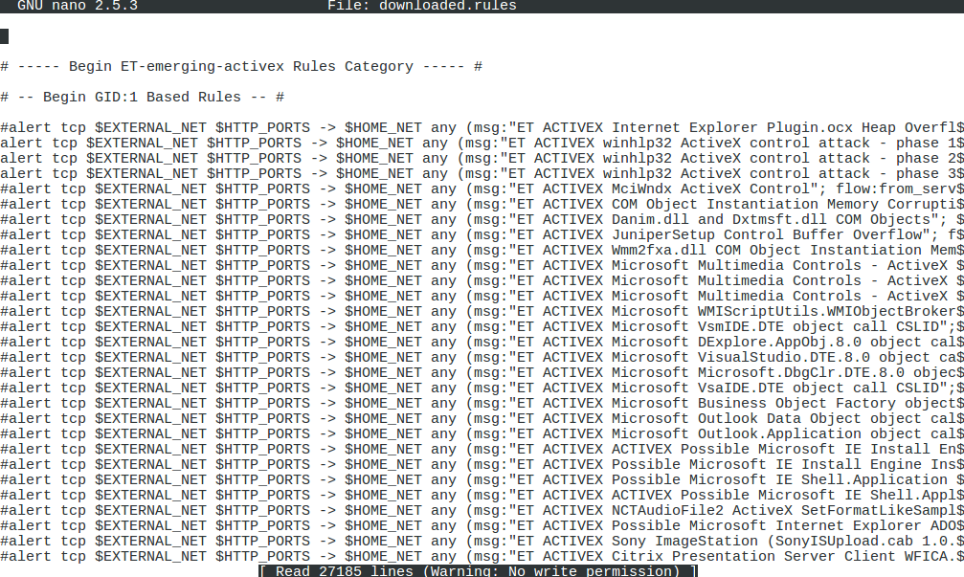
Signature-Based Detection
The below image shows the working of signature-based detection:

Slide 95


Behavior-Based Detection
Behavioral-based detection refers to an engine that has been trained to recognize normal traffic or events. It facilitates:
Training sensor with baseline normal behavior to recognize anomalous behavior Network Behavior and Anomaly Detection (NBAD)
Heuristics (learning from experience)
Statistical model of behavior
Machine learning assisted analysis, such as User and Entity Behavior Analytics (UEBA) and Network Traffic Analysis (NTA)

Slide 96

Anomaly-Based Detection
Anomaly-based detection refers to the process of analyzing specific inconsistencies while using protocols. Example:
The detection engine may compare the headers of packets or the exchange of packets within a session to RFC standards and generate an alert if they deviate significantly from strict RFC compliance.

Slide 97
Next-Generation Firewalls and Content Filters
While intrusion detection software was initially developed as stand-alone applications, its functionality was quickly incorporated into a new generation of firewalls that includes:
Unified Threat Management (UTM)
Combines security controls into single agent and management platforms
Example: Firewall, anti-malware, network intrusion prevention, spam filtering, content filtering, data loss prevention, VPN, cloud access gateway
Content or URL Filter
Focuses on outgoing user traffic
Contains content block lists and allow lists
Has time-based restrictions
Is a Secure Web Gateway (SWG)

Slide 98
Host-Based Intrusion Detection Systems
Host-Based Intrusion Detection Systems (HIDS) provide network, log, and file system monitoring for endpoints.
File Integrity Monitoring (FIM) is a critical feature of HIDS. It performs the following:
Verifies integrity of files using cryptographic hash or file signature
Compares hashes manually or verifies signature with publisher’s public key
Verifies the system files using the System File Checker tool
Tripwire and OSSEC are examples of multi-platform security tool.

Slide 99
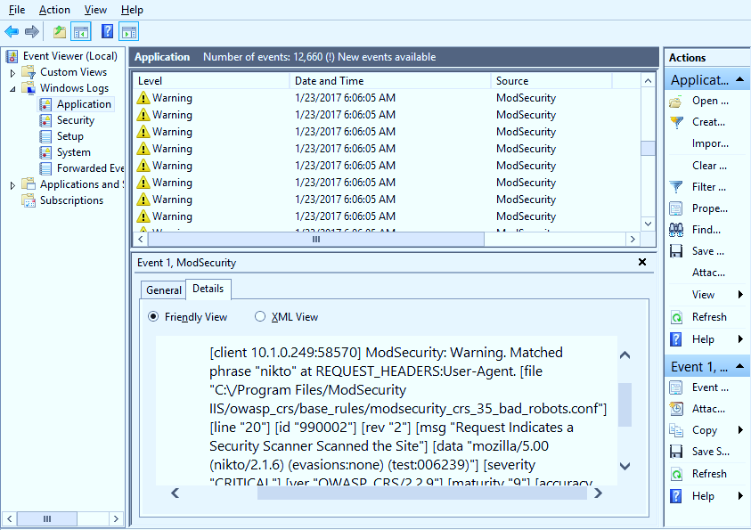
Web Application Firewalls
A Web Application Firewall (WAF) is specifically designed to safeguard software running on web servers and their backend databases against code injection and Denial of Service (DoS) attacks. They can:
¹ Inspect code in HTTP packets
2
Match suspicious code to
vulnerability database
³ Be implemented as software on host or as appliance

Slide 100
Web Application Firewalls
A WAF can be deployed as an appliance or as a web server plug-in software. The platform has several WAF products that include:
ModSecurity (modsecurity.org) is an open-source Web Application Firewall (WAF) for Apache, nginx, and IIS that is sponsored by Trustwave.
01
NAXSI is an open-source module for the nginx web server software. (github.com/nbs- system/naxsi)
Imperva (imperva.com) is a commercial web security company specialized in data centers.
03
02

Slide 101
Summarize the Use of SIEM

Slide 102
Monitoring Services
Both security assessments and incident response necessitate continuous monitoring of host and network status indicators, in addition to audit data. The types of monitoring services include:
Packet capture
Network monitors
Sniffers and flow analysis
Traffic and protocol statistics
Packet analysis
Appliance state data
Heartbeat availability monitoring
Logs
System logs
Security logs

Slide 103
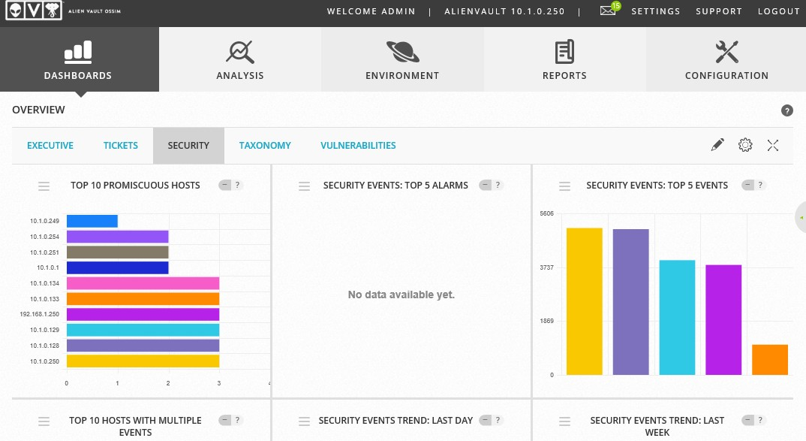
Security Information and Event Management
Security Information and Event Management (SIEM) collets data inputs from various sources in the form of logs.
Classification of Log collection:
Agent-based: Local agent to forward logs
Listener or collector: Protocol-based remote log forwarding (syslog)
Sensor: Packet capture and traffic flow data
Screenshots used with permission from AT&T Cybersecurity.

Slide 104
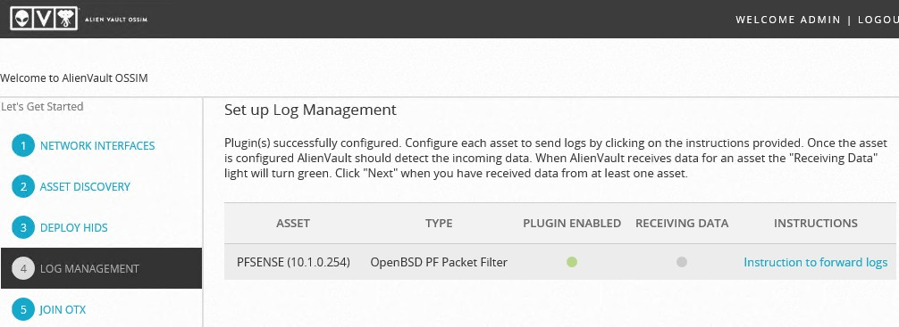
Security Information and Event Management
Log aggregation refers to the process of normalizing data from disparate sources in order to make it consistent and searchable.
Functions of log aggregation:
Consolidation of multiple log formats to facilitate search and correlation
Normalization of fields Time synchronization
Screenshots used with permission from AT&T Cybersecurity.

Slide 105
Analysis and Report Review
A SIEM is also used for reporting where collection and aggregation generate inputs. The functions are:
Correlation
User and Entity Behavior Analytics (UEBA)
Provides solution for user and entity behavior analysis
Enables the detection of malicious behaviors by comparing them to a baseline
Relates security data and threat intelligence
Alerts Indicators Of Compromise (IOC)

Slide 106
Analysis and Report Review
Sentiment Analysis
Security Orchestration, Automation, Response (SOAR)
Provides machine interpretation of natural language and emotion AI
Address the issue of an increasing volume of alerts outpacing analysts' ability to respond.

Slide 107
File Manipulation
While SIEM can automate many functions of log collection and review, data can be manually prepared using a Linux command line. The different commands are:
Cat Command Head and Tail Command
Command: cat -n access.log access2.log Output: View contents of one or more files
Command: tail /var/log/messages -n 20
Output: View first and last lines of file
Logger Command
Command: logger -n 10.1.0.242 `hostname` up
Output: Write input to system log

Slide 108
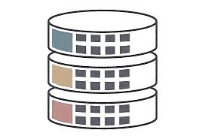
Regular Expressions and grep
Filtering a log to discover data points of interest usually involves string search that includes:
Regular expression syntax
Search operators
Quantifiers
Logic statements, and anchors or boundaries
grep
File contents
Simple string matching or regex syntax 3. grep -F 192.168.1.254 access.log
4. grep -r 192\.168\.1\.[\d]{1,3}
1
2

Slide 109
Key Takeaways
An access control list or set of rules is used to configure a packet
filtering firewall (ACL).
An application-aware firewall can inspect the contents of packets at the application layer.
Network-Based Intrusion Detection Systems is an intrusion detection system (IDS) used for performing real-time analysis of network traffic.
A SIEM is also used for reporting where collection and aggregation generate inputs.

Slide 110
CompTIA Security+ Certification - SYO-601 Exam Training

Slide 111
Domain 3: Implementation

Slide 112
Implementing Secure Network Protocols

Slide 113
Learning Objectives
By the end of this lesson, you will be able to:
Establish secure network operations protocols
Implement secure application protocols
Illustrate secure remote access protocols
Outline authentication

Slide 114
Implement Secure Network Operations Protocols

Slide 115

Network Address Allocation
Most of the networks combine static and dynamic address assignments.
DHCP automates the process of allocating network addresses.
Rogue DHCP attacks can be mitigated by allowing the DHCP snooping port security feature on a switch.
The Windows DHCP server will automatically log all detected traffic from unauthorized DHCP servers in the AD environment.
DHCP server’s administration should be closely monitored.

Slide 116
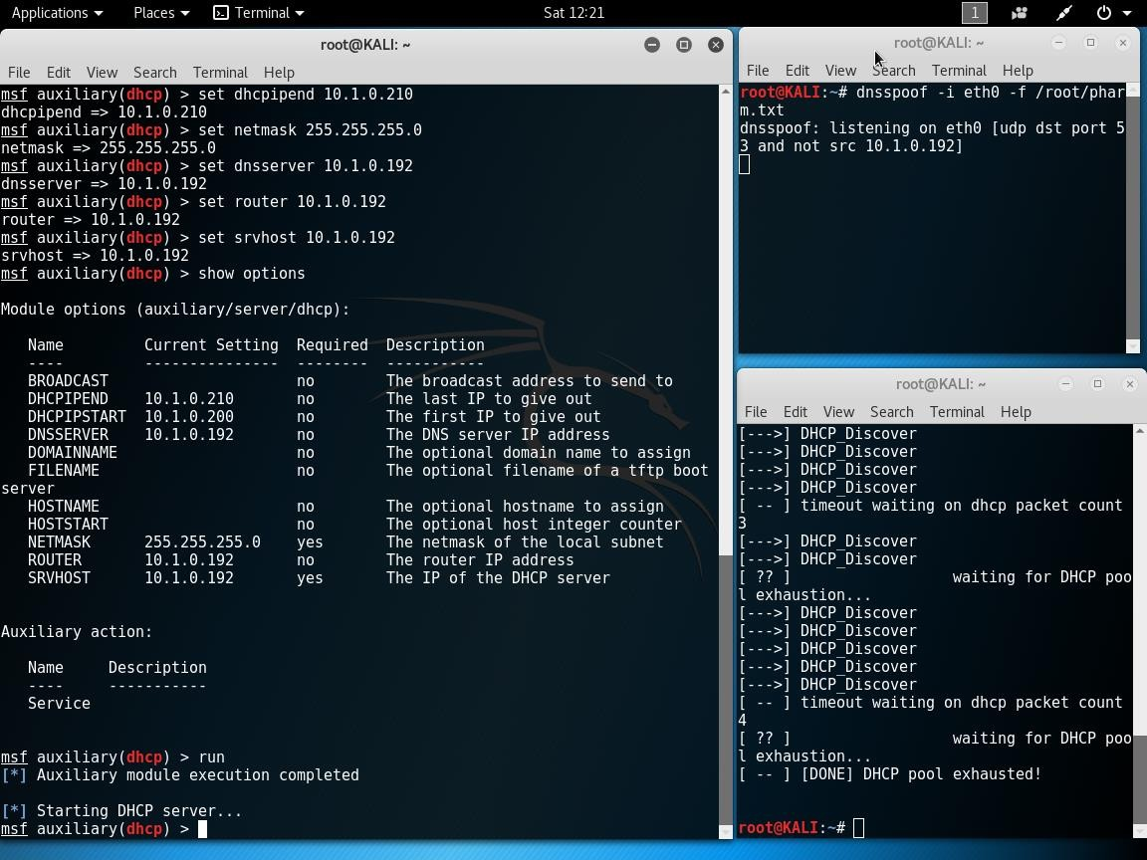
Network Address Allocation
Below is the screenshot of the attacking network address allocation:

Slide 117




Domain Name Resolution
DNS converts Fully Qualified Domain Names (FQDNs) to IP addresses.
DNS uses a distributed database system to store information about domains and hosts
located within those domains.
Approaches used by DNS:
Domain Hijacking
URL Redirection
Domain Reputation

Slide 118

Domain Hijacking
Domain name hijacking refers to an attack in which an attacker obtains a domain name containing the company trade name or trademark.
The attacker gains control of a domain name's registration.
The attacker can compromise the legitimate account used to manage the domain.
In this attack, domain is locked out of the registrar’s
management console.
whois command can be used to lookup domain registration information.

Slide 119

DNS Poisoning
DNS poisoning is an attack that subverts the process by which the client queries the server names for the IP address associated with the FQDN.
Different ways of performing DNS poisoning:
Man-in-the-Middle
DNS Server Cache Poisoning
DNS Client Cache Poisoning

Slide 120
DNS Poisoning
Man-in-the-Middle
DNS Client Cache Poisoning
If the threat actor can access the victim's local area network, ARP poisoning can be used to send a spoofed DNS response to the victim's DNS query.
An attacker who can insert the false name: the IP address into to the HOSTS file can effectively destroy the DNS cache and will be able to redirect the traffic.
DNS Server Cache Poisoning
DoS attack is launched by the attacker to
corrupt the DNS server’s own records.

Slide 121
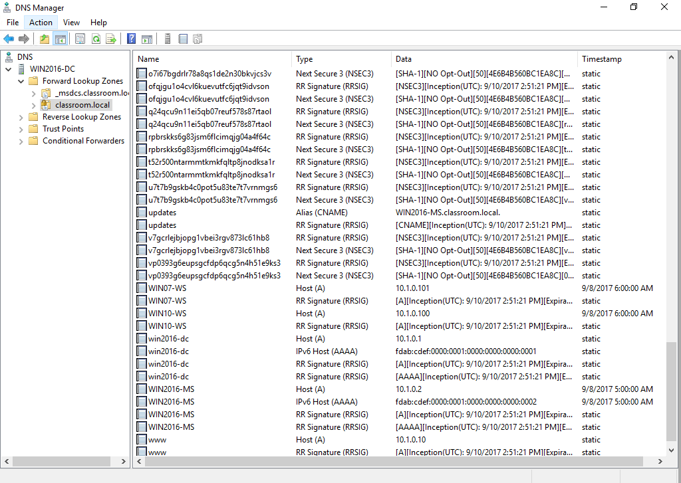
DNS Security
DNS is a mission-critical service that should be fault-tolerant by default. The screenshot of the DNS manager window is shown below:

Slide 122





DNS Security
To ensure DNS security on the private network, the local DNS server must only accept recursive queries from the local host, and not from the Internet.
The key features of DNS security are:
Fault tolerance
Authenticated recursive requests only
Access control
1
3
5
2
4
Patch management
Footprinting prevention

Slide 123
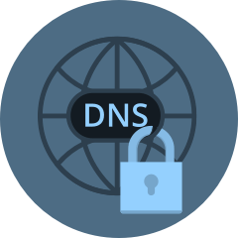
DNS Security
DNS Security Extensions (DNSSEC) provide a validation process for DNS responses, thereby mitigating against spoofing and poisoning attacks.
When DNSSEC is enabled for a zone, the authoritative server creates a package of resource records (RRset) that is signed with the zone signing key.
The signing key for the public zone is signed using a separate signing key.
DNS Root servers self-validate and establish a trust chain
between root servers and any given sub domain.
Regional internet registries validate domain trusts,

Slide 124

Secure Directory Services
A network directory contains information about the subjects and objects that are available on the network, as well as the permissions that subjects have on those objects.
Majority of directory services use the Lightweight Directory Access Protocol (LDAP) to provide highly secure services.
Basic protocol lacks security and are susceptible to sniffing and
man-in-the-middle attacks.

Slide 125
Secure Directory Services
Authentication (also known as server binding) can be accomplished in the following ways:
Simple Authentication and Security Layer (SASL)
Direct access without authentication
LDAP Secure (LDAPS)
Simple bind

Slide 126

Secure Directory Services
The two types of access given to a directory are:
Read-only access
(query)
Read or write access (update)
1
2
Unless the LDAP directory server hosts public services, the directory can only be accessed over a private network.

Slide 127
Time Synchronization
Numerous applications on networks are time-sensitive.
Some areas of implementation:
Task scheduling or backup
Authentication
Logging

Slide 128
Time Synchronization
Types of Network Time Protocols (NTP):
Stratum 1 servers
Stratum 2
servers
Simple NTP (Clients)

Slide 129


Simple Network Management Protocol Security
SNMP is a widely used framework for network management and monitoring.
SNMP is comprised of a monitor and agents.
Agent maintains a database known as a Management Information Base (MIB) that contains statistics about the device's activity.
The SNMP monitor continuously monitors all agents by polling them for information from their MIBs and displaying the results for review.

Slide 130
Simple Network Management Protocol Security
Following guidelines should be followed while using SNMP version 1 or version 2c:
Community name should never be blank or set to the default.
02
SNMP community names should not be transmitted over a network if there is any possibility of interception.
Management operations should be restricted to known hosts by utilizing Access Control Lists.
01
03

Slide 131

Simple Network Management Protocol Security
SNMP V3 supports encryption and strong user-based authentication.
1
Agents are configured with a list of usernames with their associated access rights.
2
The SNMP message is encrypted when authentication is needed.
3
Agents can verify the signature and authenticate the user by looking at their records

Slide 132
Implement Secure Application Protocols

Slide 133

HyperText Transport Protocol and Web Services
The HyperText Transfer Protocol is at the heart of web technology (HTTP).
HTTP enables clients (typically web browsers) to communicate with an HTTP server and request
resources.
HTTP headers define the response and request formats.
HTTP is a stateless protocol, which means that during a session, the server retains no information about the client.
1
2

Slide 134


HyperText Transport Protocol and Web Services
Web services or applications:
Form a mechanism that allows client to upload data to the server
Are stateless protocols but expanded with cookies and scripting

Slide 135
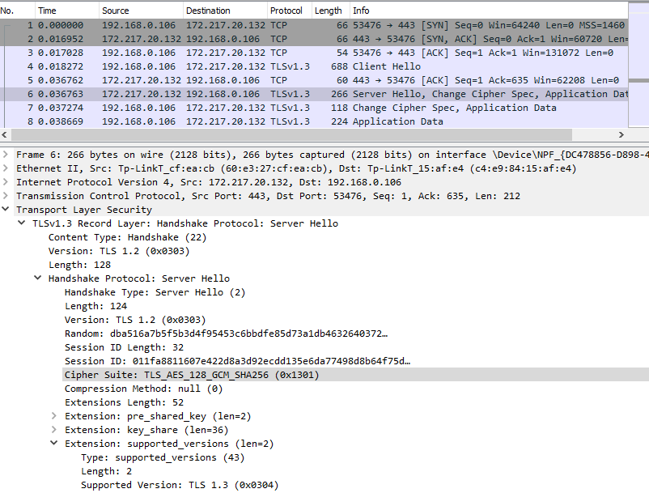
Transport Layer Security
HTTP communications are not secured. In Secure Sockets Layer (SSL), communications are secured using host certificates.
The same is shown in the screenshot given below:

Slide 136
Secure Sockets Layer (SSL) or Transport Layer Security (TLS)
SSL/TLS is usually used with HTTP applications, but it can also be used to protect other application protocols and as a Virtual Private Network (VPN) solution.
SSL/TLS Versions
Cipher Suites
Although the acronym SSL is still in use, the TLS version is the only version that is safe to use.
The server provides support for legacy clients, but this is obviously not very secure.
A cipher suite is an algorithm supported by both the client and the server to perform different encryption and hashing operations required by the protocol.

Slide 137

Cipher Suite Forms
Prior to TLS 1.3, a cipher suite would be written in the following forms:
ECDHE-RSA-AES128-GCM-SHA256
The server can use Elliptic Curve Diffie-Hellman Ephemeral mode for session key agreement.
TLS_AES_256_GCM_SHA384
The cipher suite only lists the bulk encryption key strength and mode of operation AES_256_GCM.

Slide 138


API Considerations
The primary way to configure and manage a web application is through its
Application Programming Interface (API).
The developer uses the POST method to submit data to the URL with the required
parameters coded into the request body, often in JavaScript Object Notation (JSON).
SPOST /api/users HTTP/1.1
Content-Type: application/json
{
"user": { "name": "James",
"email": "jpengelly@comptia.org"
}
}

Slide 139


API Keys
Use of APIs is authorized via a token or secret key.
APIs can use more secure authentication and authorization methods,
such as SAML and Oauth.
While deploying API, browser uses API key for security.

Slide 140

Subscription Services
Employees require access to certain subscription services.Some of them include:
Market and financial intelligence and information
Security threat intelligence and information
Reference and training materials in various formats
Software applications and cloud services paid for by subscription rather than permanent licenses

Slide 141

Subscription Services
In web feed, updated articles or news items are pushed to the client or browser.
1
Web feeds are based on either the Really Simple
Syndication (RSS) or Atom formats.
2
RSS and Atom formats use XML to mark up
documents supplied by the feed.
3
Feeds are vulnerable to XML injection style attacks.

Slide 142

File Transfer Services
The network operating system can host shared files and folders across networks.
File Transfer Protocol (FTP)
An FTP server is configured with public directories, hosting files, and user accounts.
All authentication and data transfers are transferred as plain text.
1
2

Slide 143
SFTP and FTPS
Through encryption and data transfer, SSH FTP (SFTP) addresses the privacy and integrity issues of FTP.
SFTP
FTPS
A secure link is created between the client
and server using Secure Shell (SSH) over TCP port 22.
FTP commands and data transfer are sent over the secure link without risk of eavesdropping or man-in-the-middle attacks.

Slide 144
FTP over SSL (FTPS)
There are two ways of securing FTP:
Explicit TLS (FTPES)
Implicit TLS (FTPS)
Upgrades to an unsecure connection established over port 21 using the AUTH TLS command.
Negotiates an SSL/TLS tunnel before the exchange of any FTP commands.

Slide 145

Email Services
Email services use two types of protocols:
Simple Mail Transfer Protocol (SMTP)
Mailbox Protocol
Specifies how mail is sent
from one system to another
Stores messages for users and allows them to download them to client computers or manage them on the server
1
2

Slide 146

Secure SMTP (SMTPS)
In order to deliver the message, the sender's SMTP server uses the domain name part of the email address to discover the IP address of the receiver's SMTP server.
There are two ways for SMTP to use TLS:
STARTTLS or Explicit TLS
SMTPS or Implicit TLS

Slide 147
Secure SMTP (SMTPS)
SMTP configurations use the following port and secure services:
Port 587
Used by mail clients to submit messages for delivery through the SMTP server
Port 25
Used for message relay
Port 465
Used for message submission over implicit TLS

Slide 148
Secure POP (POP3S) and Secure IMAP (IMAPS)
Types of security ports are:
Secure POP (POP3S)
Secure IMAP (IMAPS)
Compared to POP3, the Internet Message Access Protocol v4 (IMAP4) supports permanent connections to a server and connects multiple clients to the same mailbox simultaneously.
The Post Office Protocol v3 (POP3) is a mailbox protocol designed to store the messages delivered by SMTP on a server.

Slide 149








Secure or Multipurpose Internet Mail Extensions
Connection security helps in preventing email account leaks and email spoofing, but
does not guarantee end-to-end encryption.
To establish the exchange of secure emails, both users must be using S/MIME and exchange certificates.
He responds with his digital certificate and public key. Alice follows the same process and decides to trust Bob.
Alice sends Bob her digital certificate containing her public key and validated digital ID.
Bob uses the public key in the certificate to decode her signature.

Slide 150



Secure or Multipurpose Internet Mail Extensions
Alice and Bob now have both their certificates in their trusted certificate stores.
###
When Alice wants to send Bob a confidential message, she makes a hash of the message and signs the hash using her private key.
Bob receives the message and decrypts the attachment using his private key.

Slide 151
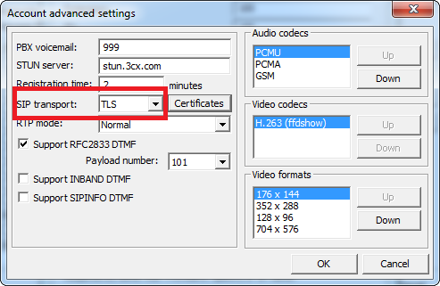
Voice and Video Protocol Security
Voice over IP (VoIP), web conferencing, and video teleconferencing (VTC) solutions are some of the standard methods of business communications.
Screenshot shows how to enable SIP/TLS security on a 3CX PBX VoIP softphone.

Slide 152
Voice and Video Protocol Security
The protocols designed to support real-time services cover one or more of the following functions:
Session control
Quality of Service(QoS)
1
3
Data transport
2

Slide 153



Session Initiation Protocol (SIP) and SRTP
SIP is most widely used session control protocols.
SIP address is assigned to each device.
Secure port 5061 is used to authenticate callers and encrypt connection setup.
SIP integrates with external networks via gateways and Private Branch Exchanges (PBX).
The actual delivery of real-time data uses Secure Real-time Transport Protocol (SRTP).

Slide 154
Implement Secure Remote Access Protocols

Slide 155

Remote Access Architecture
Remote access refers to a setup where there is no direct cable or wireless connection to
the user’s network.
The connection is executed through an intermediate network.
The VPN protocol establishes a secure tunnel to keep things
safe and private.

Slide 156

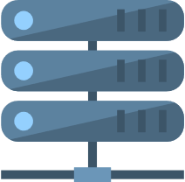




Remote Access Architecture
The working of a remote access VPN:
Remote Access Screened Subnet
Local Network
Internet
The VPN client host connects to a VPN gateway using any type of Internet subscriber access method
1
VPN
Gateway
Router or Firewall
Router or Firewall
LAN
Servers
VPN
VPN
Client
The VPN gateway authenticates the user and creates a secure encrypted
2
3
tunnel
VPN client traffic is routed over the network and can access authorized services

Slide 157
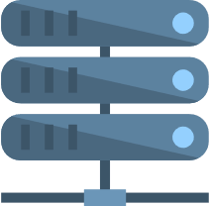





Remote Access Architecture
The working of a site-to-site VPN:
The VPN gateway at a branch office
establishes a VPN connection with
the head office site
1
Branch Office
Head Office Screened Subnet
Head Office Local Network
Router/ Firewall/VPN Gateway
Internet
VPN
Gateway
Router/ Firewall
Router/ Firewall
Branch Office Servers and
VPN
Head Office Servers
Clients
2
Traffic for a host at a remote site is automatically routed and tunneled over the VPN link

Slide 158
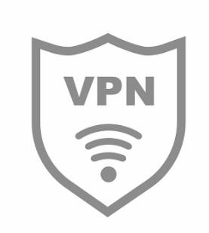
Remote Access Architecture
A VPN can also be deployed in a site-to-site model to connect two or more private networks.
The gateways exchange security information using any protocol the VPN is based on.
Hosts at each site need not to be configured with any information
about the VPN.

Slide 159
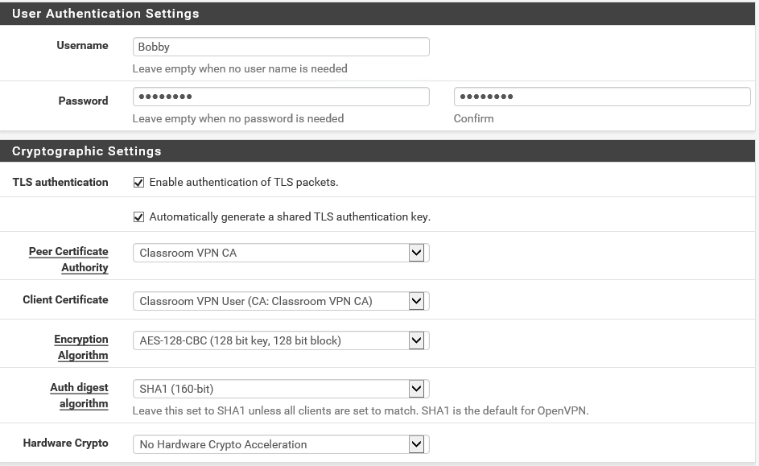
Transport Layer Security VPN
Transport Layer Security can be used to negotiate a secure connection authenticated by PKI certificates.
The window for configuring an OpenVPN server in the pfSense security appliance is shown below:

Slide 160

Transport Layer Security VPN
Transport Layer Security (TLS) and IPSec are now the preferred options for configuring VPN access.
A TLS VPN (still more commonly referred to as an SSL VPN) requires a remote access server listening on port.
Once the user is authenticated and the connection is fully established, the VPN gateway tunnels all communications for the local network over the secure socket.

Slide 161

Internet Protocol Security (IPSec)
By using a separate secure port or by using commands in the application protocol to negotiate secure connections, transport layer security can be applied at the application level.
IPSec operates at the network layer (layer 3) of the OSI
model.
1
2
IPSec can provide both confidentiality and integrity.
3
IPSec can be used to secure communications on local networks and as a remote access protocol.

Slide 162
Internet Protocol Security (IPSec)
Protocols used in IPSec are :
Authentication Header (AH)
Encapsulation Security Payload (ESP)
Signs packet but does not encrypt payload
Provides confidentiality and/or authentication or integrity
Provides only authentication or integrity

Slide 163
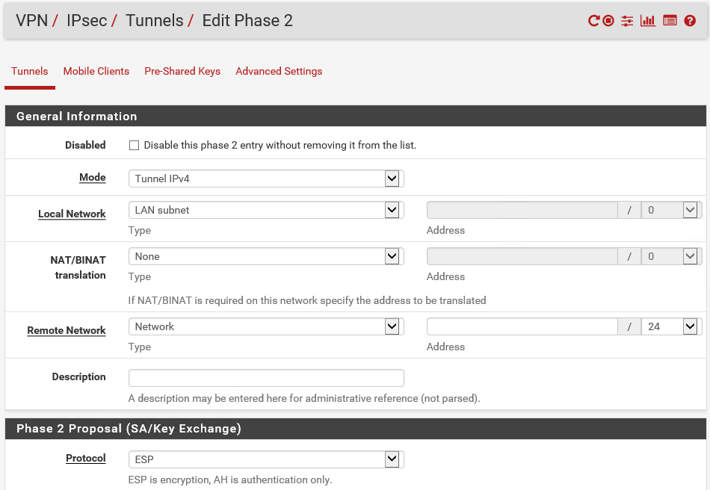
IPSec Transport and Tunnel Modes
PSec datagram using AH and ESP in transport mode:
IPSec datagram using ESP in tunnel mode:
IP Header
AH
Trailer
ICV
TCP/UDP
Payload
ESP
New
IP Header
Trailer
IP Header | TCP/UDP | Payload
ESP
ICV

Slide 164
IPSec Transport and Tunnel Modes
IPSec can be used in two modes:
Transport mode
This mode is used to secure communications between hosts on a private network (an end-
to-end implementation).
Tunnel mode
This mode is used for communications between VPN gateways across an unsecure network (creating a VPN).

Slide 165
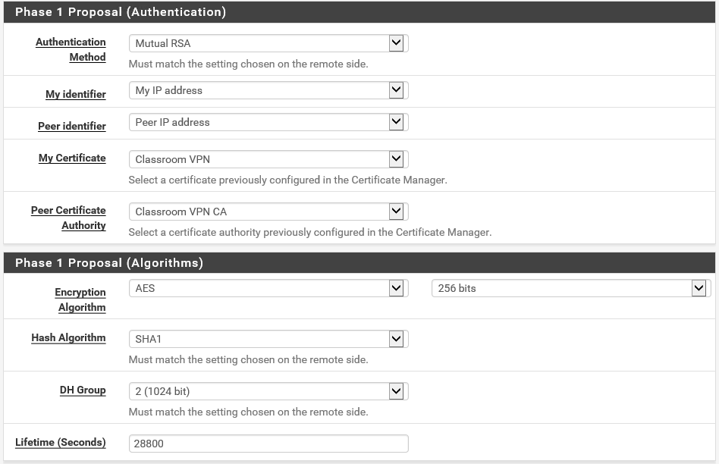
Internet Key Exchange
IPSec's encryption and hashing functions depend on a shared secret.
The Internet Key Exchange (IKE) protocol handles authentication and key exchange referred to as
Security Associations (SA).

Slide 166

Internet Key Exchange
IKE negotiations take place over two phases:
Phase I
Phase II
It is used to add digital certificates.
Digital certificates and pre-shared key methods are used for authentication.
Phase II uses the secure channel created in Phase 1 to establish with ciphers.
Key sizes will be used with AH and/or ESP in the IPSec session.

Slide 167
Layer 2 Tunneling Protocol and IKE v2
This first version of IKE is optimized to ensure the mutual authentication of two peer
hosts, such as in a site-to-site VPN.
For remote access VPNs, a combination of IPSec with the Layer 2 Tunneling Protocol (L2TP) VPN protocol is often used.

Slide 168



Layer 2 Tunneling Protocol/IPSec VPN
A L2TP/IPSec VPN would typically operate as follows:
The client and a secure IPSec VPN gateway set up channel over the Internet using either a pre-shared key or certificates for IKE.
The VPN gateway uses L2TP to set up a tunnel to exchange local network data encapsulated as Point-to-Point Protocol (PPP) frames.
The user authenticates over the PPP session using EAP or CHAP.

Slide 169

IKE v2
The drawbacks of the original version of IKE were addressed by an updated protocol.
IKE v2 has some additional features that have made the protocol popular for use as a standalone
remote access VPN solution. It includes:
Makes IPSec a standalone remote access VPN protocol
Reduces number of setup messages
Supports multihoming on client device (switching between
Wi-Fi and cellular data)
Supports EAP user authentication methods

Slide 170

VPN Client Configuration
To configure a VPN client, users may need to install the client software if the VPN type is not natively supported by the OS.
Users may also need to deploy a client certificate that is trusted by the VPN concentrator to the machine and make that available to the VPN client.

Slide 171
VPN Client Configuration
Traditional remote access VPN solutions require the user to initiate the connection and enter their authentication credentials. It includes:
Always-on VPN
Configures VPN to start automatically when trusted network link is detected
Split Tunnel
Full Tunnel
Allows the client to access the Internet directly using its native IP configuration and DNS servers
Mediates Internet access by the corporate network

Slide 172
Remote Desktop
A remote access VPN joins the user's PC or smartphone to the local network via the secure tunnel. It uses tools such as:
Secure Shell (SSH)
A protocol such as Secure Shell (SSH) only supports terminal access, but there are many
other tools that can connect to a graphical desktop.
GUI Remote Administration
A GUI remote administration tool sends screen and audio data from the remote host to the client and transfers mouse and keyboard inputs from the client to the remote host.

Slide 173


Remote Desktop
Microsoft's Remote Desktop Protocol (RDP) can be used to access a physical machine on a one-to-one basis. It is a:
GUI-based remote terminal software
Remote Desktop Protocol (RDP) that connects to physical machines, RDP gateway, virtual desktops, and apps.
HTML5 VPN or clientless remote desktop gateway enables access to desktops and web applications from the Internet via gateway to internal network. It uses the WebSockets protocol.

Slide 174








Out-of-band Management and Jump Servers
The screenshot of securing management traffic using a jump server is given below:
A VPN can be used to access the jump server, which authorizes and forward- management traffic to the app server
Screened Subnet
VPN
Gateway
Enterprise Network
Router/
VPN Client
1
Firewall
Secure Administrative Workstation(SAW)
Management traffic from authorized hosts on the network can also be routed via the jump server
VPN
2
Secure Administrative Workstation(SAW)
SSH
Connection Request
Management
Jump Servers
Traffic
Unsecure Workstation
3
Browsing
Traffic
APP
Servers
Management traffic from unauthorized hosts is not permitted
Router/
Firewall
4
The app servers only accept management traffic connections from the jump server
Internet
5
Ordinary application traffic uses a different network

Slide 175

Out-of-Band Management and Jump Servers
Remote access management refers to the specific use case of using a secure channel to administer a network appliance or server.
SAWs should be denied Internet access or be restricted to a handful of approved vendor sites (for patches, drivers, and support).

Slide 176

In-Band Management
An in-band management link is one that shares traffic with other communications on the production network.
A serial console or modem port on a router is a physically out-of- band management method.
With an in-band connection, better security can be implemented by using a VLAN to isolate management traffic.

Slide 177



Jump Servers
One of the challenges of managing hosts that are exposed to the Internet, such as in a DMZ or cloud virtual network, is to provide administrative access to the servers and appliances located within it.
Single host accepts SSH or RDP connections from SAWs.
Forwards connections to app servers
App servers only accept connections from jump server.

Slide 178

Secure Shell (SSH)
Secure Shell (SSH) helps to obtain secure remote access to a command-line terminal.
SSH is used for remote administration and Secure File Transfer (SFTP).
SSH servers are located by a public or private key pair.

Slide 179
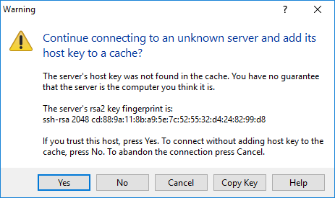
SSH Client Authentication
SSH allows various methods for the client to authenticate the SSH server.

Slide 180
Secure Shell (SSH)
These are the methods allowed by SSH for the client to authenticate the SSH server.
Each of these methods can be enabled or disabled as required on the server using the /etc/
ssh/sshd_config file:
Username or password
Public key
authentication
Kerberos

Slide 181
SSH Commands
SSH commands are used to connect to hosts and set up authentication methods.
ssh-keygen -t rsa
ssh-copy-id bobby@10.1.0.10
ssh bobby@10.1.0.10tunnel
To connect to an SSH server at
10.1.0.10 using an account named "bobby" and password authentication.
To create a new key pair and copy it to an account on the remote server.

Slide 182
Key Takeaways
DNS uses a distributed database system to store information about
domains and hosts located within those domains.
To ensure DNS security on the private network, the local DNS server must only accept recursive queries from the local host, and not from the Internet.
The primary way to configure and manage a web application is through its Application Programming Interface (API).
One of the challenges of managing hosts that are exposed to the Internet is to provide administrative access to the servers and appliances located within it.
Secure Shell (SSH) is the principal means of obtaining secure
remote access to a command-line terminal.

Slide 183
CompTIA Security+ Certification - SYO-601 Exam Training

Slide 184
Domain 3: Implementation

Slide 185
Implementing Host Security Solutions

Slide 186
Learning Objectives
By the end of this lesson, you will be able to:
Implement secure firmware Illustrate endpoint security Analyze embedded systems
Outline embedded system security implications

Slide 187
Implement Secure Firmware

Slide 188
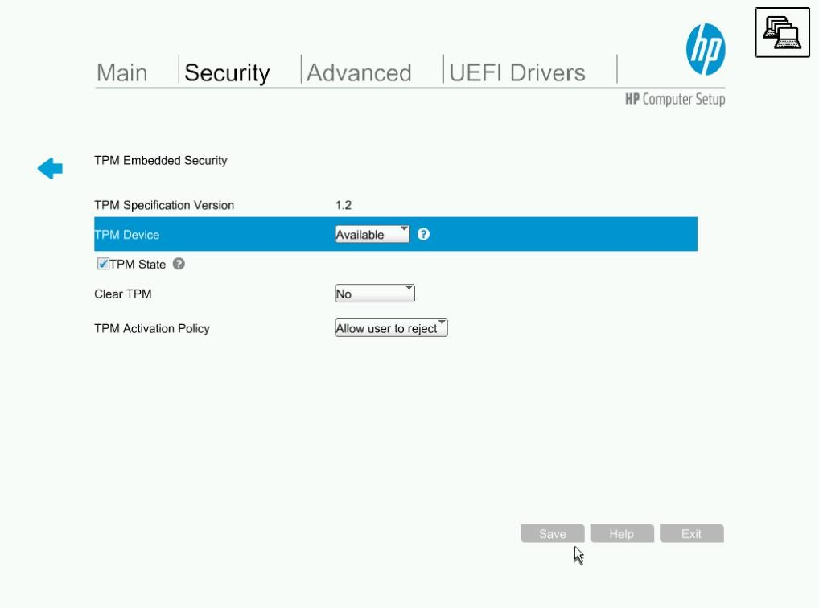
Hardware Root of Trust
A Hardware Root of Trust (RoT) or trust anchor is a secure subsystem that can provide attestation. Attestation ensures that the statement made by the system can be trusted by the receiver.
The screenshot shows the configuration of a Trusted Platform Module using system setup on an HP workstation.

Slide 189

Network Address Allocation
The RoT is established by a type of cryptoprocessor called a Trusted Platform Module (TPM).
Features of a TPM are:
It is a hardware-based storage of cryptographic data.
Each TPM is hard-coded with a unique and unchangeable asymmetric private key called the endorsement key.
This endorsement key is used to create various other types of
subkeys used in key storage, signature, and encryption operations.
Its ownership is secured via password.

Slide 190
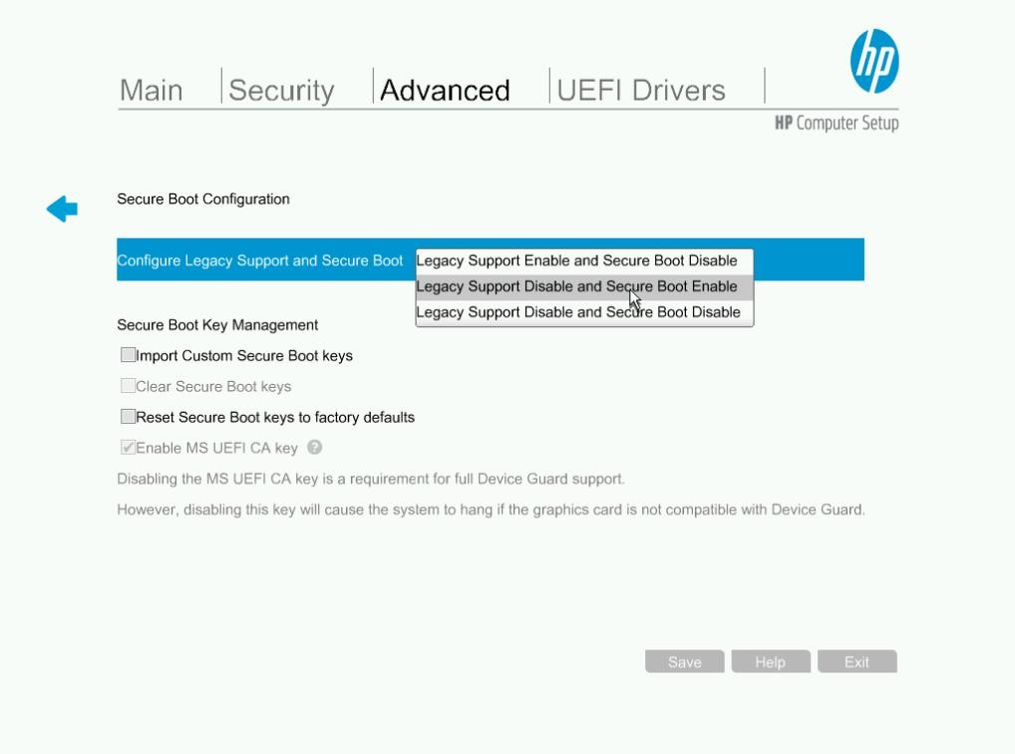
Boot Integrity
Most PCs and smartphones implement the Unified Extensible Firmware Interface (UEFI).
UEFI provides code that allows the host to boot from an OS.
The screenshot shows the configuration of secure boot settings via an HP
workstation’s UEFI
firmware setup program.

Slide 191



Boot Integrity
Types of boot integrity checks enforced by UEFI are:
Secure Boot
Measured Boot
Boot Attestation

Slide 192
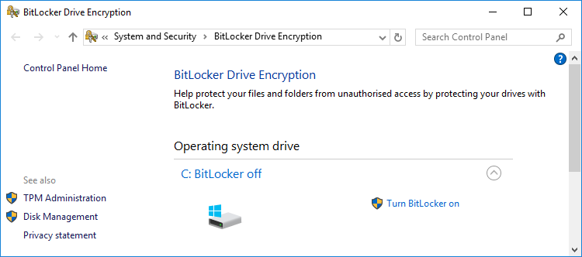
Disk Encryption
Activating BitLocker drive encryption:

Slide 193
Disk Encryption
Types of drive or disk encryption are:
Full Disk Encryption (FDE)
Self-Encrypting Drives (SED)
Encryption key is secured with user
password.
It uses a data or media encryption key
(DEK or MEK) for bulk encryption.
It uses an Authentication Key (AK) or key encrypting key.
It is developed according to the Opal storage specification .
Secure storage for keys is TPM or USB
thumb drive.

Slide 194
USB and Flash Drive Security
BadUSB exposes the system to:
Malicious USB cable
02
Malicious firmware
01
03
Malicious flash drive

Slide 195



USB and Flash Drive Security
The modified device contains visual cues or signals that differentiates it from drive or cable. It:
Warns users of the risks from connecting devices to unknown origin
Suggests users to take a close look at the sandbox laboratory system also referred as sheep dip
Suggests users to look for command prompt windows or processes

Slide 196
USB and Flash Drive Security
BadUSB and Cybersecurity Sheep Dipping techniques are used for the security of the drive.
BadUSB
Cybersecurity Sheep-Dipping
BadUSB is a technique for conceptually infecting any USB device with a virus.
Cybersecurity Sheep-Dipping is a technique used to secure and keep networks malware free.

Slide 197




Third-Party Risk Management
Third-party risk management includes the following considerations:
Supply chain refers to the end-to-end process of supplying, manufacturing, distributing, and finally releasing goods and services to a customer.
Anyone with the time and resources to modify a computer's firmware can
create backdoor access.
Companies must depend on governments or security services to ensure
trustworthiness of market suppliers.
Third-party considers implication of using second-hand equipment.

Slide 198
Vendors vs. Business Partners
The two types of supplier relationships are:
Vendors
Business Partners
Refers to a supplier of commodity goods and services with a level of customization and support.
Refers to a closer relationship where two companies share aligned goals and marketing opportunities, and work as partners

Slide 199
End of Life Systems and Lack of Vendor Support
EOL or End of Life is a phase where a manufacturer discontinues selling a product.
In EOL phase, there is limited support and availability of spares and updates.
In EOL phase, the product is no longer sold to new customers.
An End of Service Life (EOSL) system will not be supported by its developers and vendors.
An EOL system lacks the availability of updated software and peripheral devices.

Slide 200
Organizational Security Agreements
The following are the types of organizational security agreements:
Memorandum of Understanding (MOU)
It is intended to work together.
Business Partnership Agreement (BPA)
It is used to establish a formal partner relationship.
Non-Disclosure Agreement
It governs use and storage of shared confidential and private information.

Slide 201
Organizational Security Agreements
The following are the types of organizational security agreements:
Measurement Systems Analysis (MSA)
It is used to evaluate data collection and statistical methods used for quality management.
Service Level Agreement (SLA)
It is used to establish metrics for service delivery and performance.

Slide 202
Implement Endpoint Security

Slide 203
Host Hardening
Hardening refers to placing an operating system or application in a secure configuration.
The following reduces the potential attack surface:
Interfaces
Services
Provides a connection to a network, peripheral connections, and hardware ports
Supports remote connections from clients to server applications

Slide 204
Host Hardening
Application service ports
Persistent storage
It includes TCP and UDP ports.
It holds user data generated by applications along with cached
credentials.
It disables application services or
used firewall to control access.
It detects non-standard usage.

Slide 205
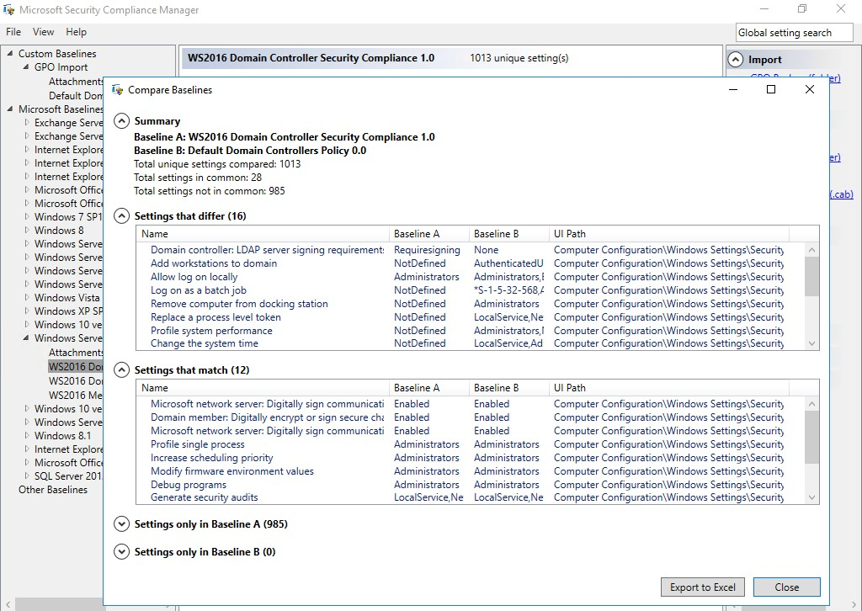
Baseline Configuration and Registry Settings
Security Compliance Manager is used to compare settings in a production GPO with Microsoft's template policy settings.

Slide 206
Baseline Configuration and Registry Settings
On a Windows domain network, each domain-joined computer receives policy settings from Group Policy Objects (GPOs).
These policy settings are applied to the registry when each time
a computer boots.
In GPOs hosts are managed centrally.
Group Policy Objects
(GPOs)
In GPOs Rights to modify the registry is granted to least privileged user and service accounts.
In GPOs host can be configured to alert on suspicious registry events.

Slide 207

Patch Management
All types of OS, application, and firmware code potentially contain vulnerabilities. Patch management is essential for mitigating these vulnerabilities as they are discovered.
Limitations with reference to update policies and schedule are that they are:
Applied to all latest auto-updates
Applied only to specific patches
Applied to third-party patches

Slide 208

Patch Management
When multiple applications run update clients on the same host, performance issues arises.
These issues can be mitigated by deploying an enterprise patch management suite.
It is difficult to schedule patch operations.

Slide 209
Endpoint Protection
Configuring endpoint protection is crucial step in hardening for automatic detection and prevention of malware threats.
Types of endpoint protection suite or agents are:
Host-Based Intrusion Detection or
Prevention (HIDS or HIPS)
Antivirus (A-V) or Anti-Malware
It helps in file integrity monitoring and log or network traffic scanning.
Prevention products can block processes or network connections.
It performs signature-based detection of all malware or PUP types.

Slide 210
Endpoint Protection
Endpoint Protection Platform (EPP)
Endpoint Protection Deployment
Data Loss Prevention (DLP)
It consolidates agents for multiple functions.
It combines A-V, HIDS, host firewall, content filtering, encryption, etc.
It configures management systems to push updates.
It blocks copy or transfer of confidential data.

Slide 211




Endpoint Protection Deployment
Few generic tasks to implement endpoint protection include:
Testing the different host group configuration settings
Configuring the management system to push updates
Assigning hosts to
appropriate groups
Using monitoring dashboard

Slide 212
Next-Generation Endpoint Protection
Next-generation endpoint protection is focused on logging of endpoint observables and indicators combined with behavioral- and anomaly-based analysis.
Endpoint Detection and Response
(EDR)
Next-generation Firewall Integration
Focuses on visibility and containment,
rather than preventing malware execution
Driven by cloud-hosted machine learning for user and entity behavior analytics
Uses endpoint detection to alter network firewall policies
Bocks fileless threats and covert channels
Prevents lateral movement

Slide 213

Antivirus Response
An on-access anti-virus scanner or intrusion prevention system identifies any suspicious activities when processes or scripts are executed. It contains:
Signature-based detection and heuristics
Malware-identification and classification Manual remediation advice
Advanced malware tools Sandbox

Slide 214
Embedded System Security Implications

Slide 215

Embedded Systems
An embedded system refers to a complete computer system designed to perform a specific and dedicated function in a static environment.
The user can add or remove programs and data files, install new hardware components, and upgrade the operating system.

Slide 216



Embedded Systems
Features of embedded systems are:
Crypto, authentication, and implied trust constraints
Cost, power, and
compute constraints
Network and range constraints
Single-purpose devices with no overhead for additional security computing
Power constraint range
Emphasize low data rates, but minimize latency
Limited resource for cryptographic implementation
No root of trust
Perimeter security

Slide 217

Logic Controllers for Embedded Systems
Embedded systems are based on firmware running on a Programmable Logic Controller (PLC). Some hardware and software components on which PLCs are built:
System on Chip (SoC)
Processors, controllers, and devices all provided on single package
Examples of SoC are Raspberry Pi and Arduino
Field Programmable Gate Array (FPGA)
End customer can configure programming logic
Real-Time Operating System (RTOS)
Designed to be ultra-stable
Prioritizes real-time scheduling

Slide 218
Embedded Systems Communications Considerations
With improvement in technology, the use of standardized communication technologies is becoming more prevalent. Some of the communication technologies include:
Operational Technology (OT) Networks
Operational technology (OT) networks typically use either serial data protocols or industrial Ethernet.

Slide 219
Embedded Systems Communications Considerations
Cellular Networks or Baseband Radio
There are several baseband radio technologies such as:
Narrowband-IoT (NB-IoT)
It is a low-power version of the Long Term Evolution (LTE) or 4G cellular standard.
LTE Machine Type Communication (LTE-M)
It is another low-power system, but supports higher bandwidth.
It uses Subscriber Identity Module (SIM) card as an identifier.
In LTE, Encryption and backhaul are the responsibilities of network operator.

Slide 220
Embedded Systems Communications Considerations
Z-Wave and Zigbee
There are wireless communications protocols used primarily for home automation.
Z-Wave and Zigbee use low-power wireless over ~900 MHz and 2.4 GHz respectively.
Both have communication encryption.

Slide 221
Industrial Control Systems
Industrial processes prioritize availability and integrity over confidentiality, reversing the CIA triad as the AIC triad. It provides mechanism for:
Workflow and Process Automation Systems
Industrial Control Systems (ICSs)
Plant devices and embedded PLCs
OT Network
Electromechanical Components and Sensors
Human Machine Interface (HMI)
Data Historian

Slide 222


Industrial Control Systems
Supervisory Control and Data Acquisition (SCADA)
A supervisory control and data acquisition (SCADA) system takes the place of a control server in large-scale, multiple-site ICSs. It:
Runs on PCs to gather data and perform monitoring
Manages large-scale, multiple site installations over WAN communications

Slide 223
Industrial Control Systems
ICS or SCADA application systems used in different industries include:
Logistics
Moving things
Facilities
Site and building management systems
Heating, Ventilation, and Air
Conditioning (HVAC)
Energy Power generation and distribution
Functions of different units
Industrial
Mining and refining
raw materials
Fabrication and Manufacturing Creating components and assembling them into products

Slide 224
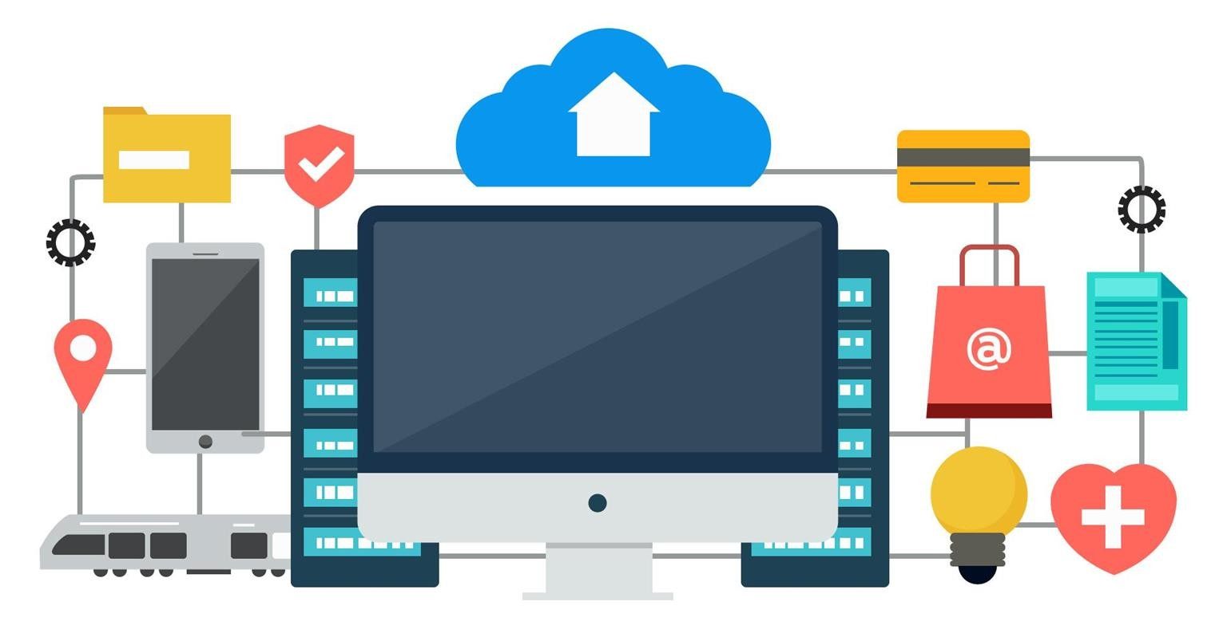
Internet of Things
It is used to describe a global network of appliances and personal devices, equipped
with sensors, software, and network connectivity.
Allows objects and servers to communicate and pass data between each other.

Slide 225


Internet of Things
An IoT network uses the following types of components:
Sensors
Hub control system
Smart devices
Wearables
Vendor security management

Slide 226
Specialized Systems for Facility Automation
A specialized system is the embedded systems and IoT devices used for a
specific purpose or application. It includes:
Building Automation System
(BAS)
Smart buildings
Process and memory vulnerabilities
Credentials embedded in
application code
Code injection
Smart Meters
Surveillance Systems
Updation of reports on electricity, gas, or water usage to the supplier
Cellular data for communication
Physical Access Control System (PACS)
Risks from third-party provision
Abuse of cameras

Slide 227
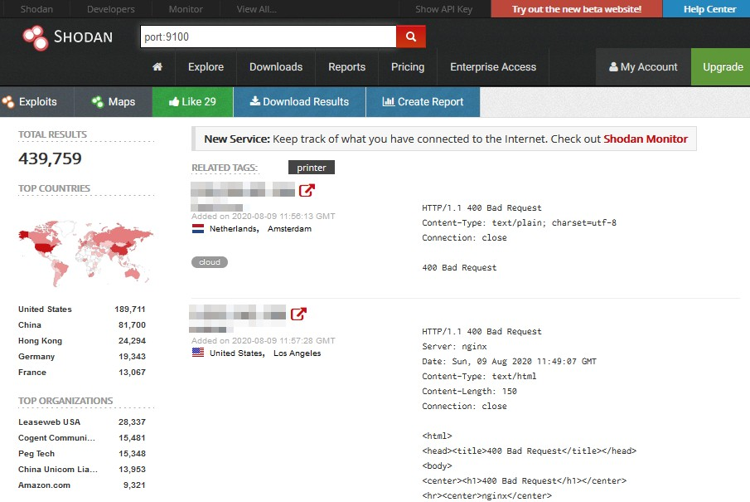
Specialized Systems in IT
There are specialized systems installed within office networks, such as printer and Voice Over IP (VoIP) equipment.

Slide 228
Specialized Systems in IT
These specialized systems are installed within office networks, and they must not be overlooked by security monitoring procedures.
Multifunction Printers (MFPs)
These machines have their own hard drives and firmware that are potential for vulnerabilities.
From these machines, recovery of confidential information from cached print files is possible if files are not securely deleted.
In these machines, log data might assist attacks.
These machines can also be as pivot points to compromise other network devices.

Slide 229
Specialized Systems in IT
These specialized systems are installed within office networks, and they must not be overlooked by security monitoring procedures.
Voice over IP (VoIP)
Embedded systems are used to implement Voice over IP (VoIP) endpoints and media
gateways.
Shodan
Shodan is the world's first search engine for Internet-connected devices. It helps discover how Internet intelligence can help user make better decisions.

Slide 230

Specialized Systems for Vehicles and Drones
Unmanned Aerial Vehicles (UAV) contain sophisticated electronics to control
engine and power systems. Some of these systems are:
1
Computer-controlled or assisted engine, steering, and brakes
2
In-vehicle entertainment and navigation system
3
Controller Area Network (CAN) serial communications buses

Slide 231

Specialized Systems for Medical Devices
Medical devices have potentially insecure protocols and control systems.
Attacking a medical device may have the following goals:
1
To use compromised devices to pivot to networks storing medical data with the aim of stealing protected health information (PHI)
2
To hold medical units ransom by threatening to disrupt services
3
To kill or injure patients (or threaten to do so) by tampering with dosage levels or device settings

Slide 232
Security for Embedded Systems
The following methods can be used to mitigate risk in embedded system environments:
Network Segmentation
Wrappers
Strict access restriction to OT networks
Increased monitoring for SCADA hosts
IPSec usage for authentication,
integrity, and confidentiality

Slide 233
Security for Embedded Systems
The following methods can be used to mitigate risk in embedded system environments:
Firmware Code Control
Inability to Patch
Inadequate vendor support
Time-consuming patch procedures
Inability to schedule downtime
Supplies chain risks

Slide 234
Key Takeaways
A Hardware Root of Trust (RoT) or trust anchor is a secure subsystem that is able to provide attestation.
Most PCs and smartphones implement the Unified Extensible Firmware Interface (UEFI). UEFI provides code that allows the host to boot from an OS.
Embedded systems are normally based on firmware running on a programmable logic controller (PLC).
A specialized system refers to the use of embedded systems and IoT devices for a specific purpose or application.

Slide 235
CompTIA Security+ Certification - SYO-601 Exam Training

Slide 236
Domain 3: Implementation

Slide 237
Implementing Secure Mobile Solutions

Slide 238
Learning Objectives
By the end of this lesson, you will be able to:
Illustrate mobile device management
Implement secure mobile device connections
Outline enterprise mobility management
List cellular and GPS connection methods

Slide 239
Implement Mobile Device Management

Slide 240

Mobile Device Deployment Models
A mobile device deployment model explains the process of how the employees are supplied with mobile devices and applications. It can be:
Bring Your Own Device
(BYOD)
Corporate Owned, Business Only (COBO)
01
02
Corporate Owned, Personally-Enabled (COPE)
Choose Your Own Device
(CYOD)
03
04
05
Virtual Desktop Infrastructure (VDI)

Slide 241
Enterprise Mobility Management
Enterprise Mobility Management (EMM) is a class of management software that applies security policies for use of mobile devices and applications in the enterprise.
It helps in visibility over use and configuration.
It helps in managing enterprise-owned devices and BYOD.

Slide 242
Enterprise Mobility Management
The main functions of an EMM product site are as follows:
Mobile Device Management (MDM)
Involved in network enrollment.
Helps in managing device functions.
Mobile Application Management (MAM)
Involved in installing and monitoring of corporate apps and data.
Unified Endpoint Management (UEM)
It aims for visibility across PC, laptop, smartphone, tablet, and even IoT devices.

Slide 243
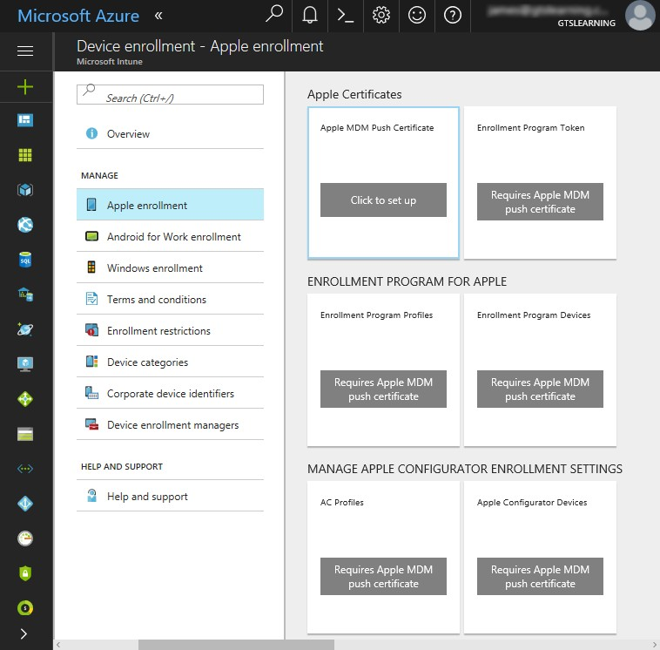
iOS in the Enterprise
App development includes:
Software Development Kit (macOS only) App store
Device enrollment program
Volume purchase program Developer enterprise program
Configuring iOS device enrollment in Microsoft's Intune EMM suite.

Slide 244

Android in the Enterprise
The following are the vulnerabilities faced by a user on an Android device:
Apps in android are not updated quickly.
Android OS is more exposed to threats.
1
2

Slide 245
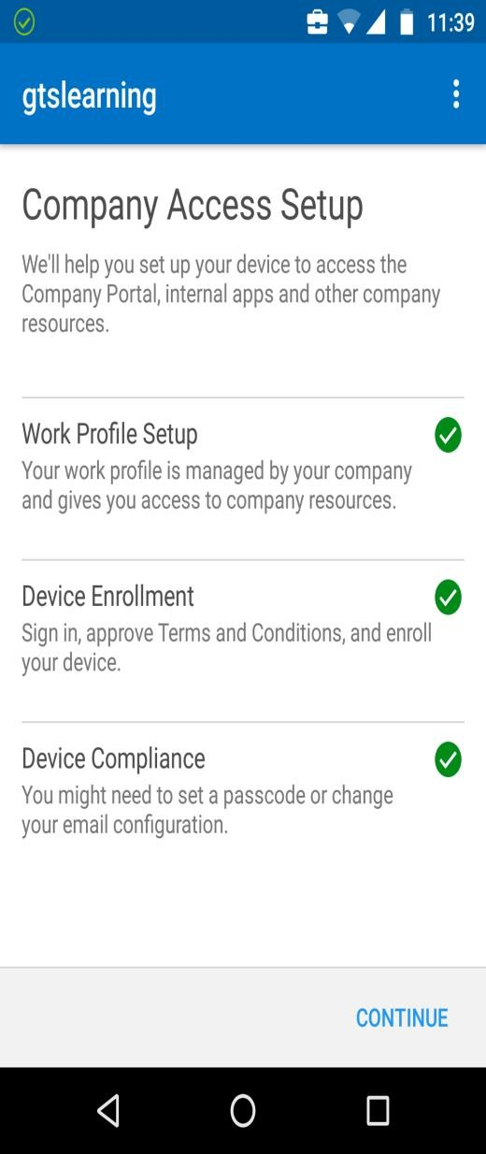
Android in the Enterprise
Security Enhanced Android (SEAndroid) uses Mandatory Access Control (MAC) policies to
run apps in sandboxes.
App grants access to specific features such as:
Contact Details
SMS Texting
Email
Enrollment of an Android smartphone with Intune.

Slide 246

Mobile Access Control Systems
The security and privacy of a smartphone is ensured by the following authentications:
Password
Swipe
Pattern
Biometric
PIN

Slide 247

Mobile Access Control Systems
A screen lock mechanism, such as a password, pin, or pattern can be used to protect a user’s
smartphone from any intervention.
Context-aware authentication helps a user unlock the smartphone in case of password loss.

Slide 248
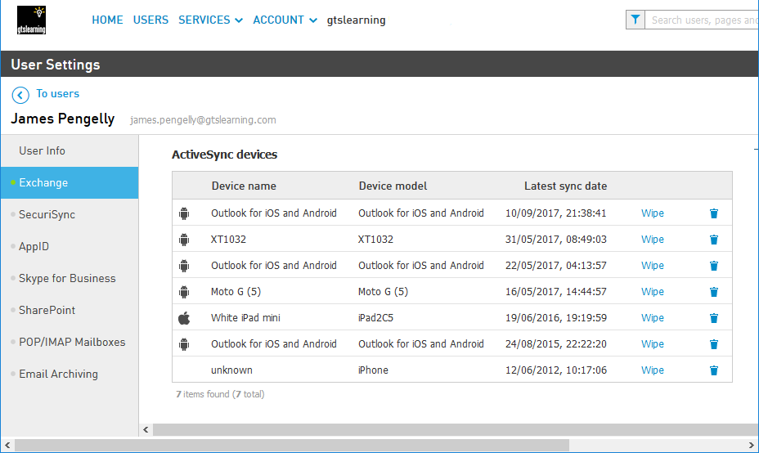

Remote Wipe
Remote wipe or kill switch is initiated from the enterprise management software.
It sets the device to factory defaults or clears storage in case the smartphone gets stolen. The remote wipe will be triggered when the thief enters the wrong password multiple times.
The thief might be able to keep the device from receiving the wipe command.
The screenshot here shows the corporate messaging service by Intermedia.

Slide 249



Full Device Encryption and External Media
The various levels of encryption in an iOS device are:
Secure erase encryption
It is used for wiping the device in case of threats. The OS just needs to delete the key to make the data inaccessible rather than wiping each storage location.
Data protection
It is used as a second round of encryption using a key
derived from and protected by the user's credential.

Slide 250



Full Device Encryption and External Media
In Android, the encryption depends on the version of software installed on the device.
By default, user data is encrypted at file-level from Android version 10.
External storage devices are used to extend device storage capacity.
MicroSD HSM is a small device designed to store extra essentials.

Slide 251


Location Services
Geolocation uses network attributes to help a user determine the physical position of a device
when it’s lost.
Location services make use of two location systems:
Global Positioning System (GPS)
Indoor Positioning System (IPS)

Slide 252
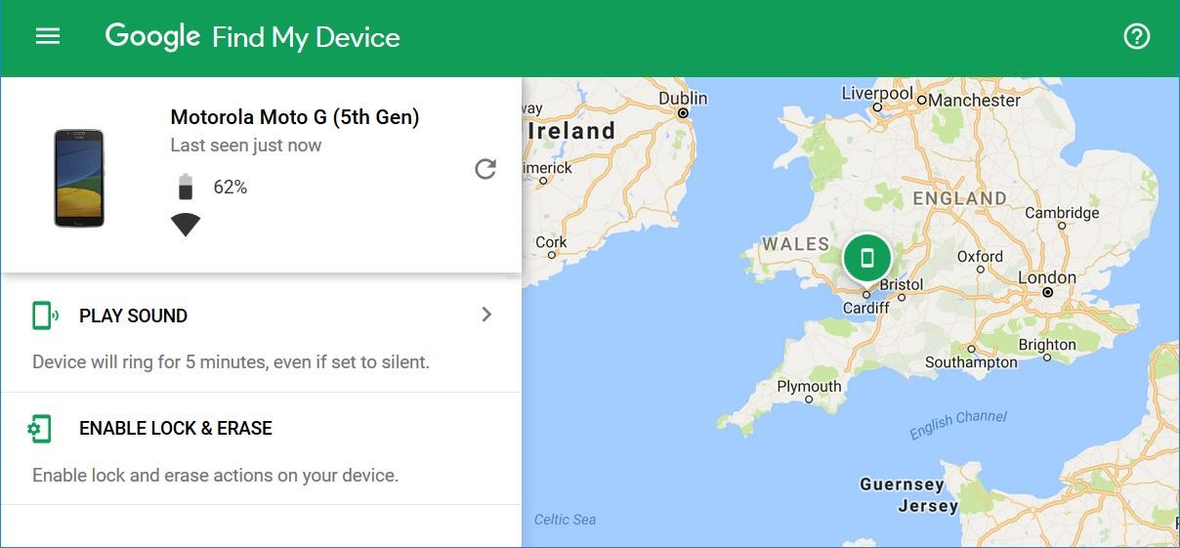
Geofencing
Geofencing applies location-based policies automatically and helps disable on-board camera or video through MDM or EMM controls.
Using Find My Device to locate an Android smartphone

Slide 253

GPS Tagging
GPS tagging refers to the process of including the geographical identification metadata in a device.
GPS tagging is a highly sensitive to personal information
and therefore it is a risk to personal information.
GPS tagging helps in tracking movements of a person
and assist social engineering.

Slide 254
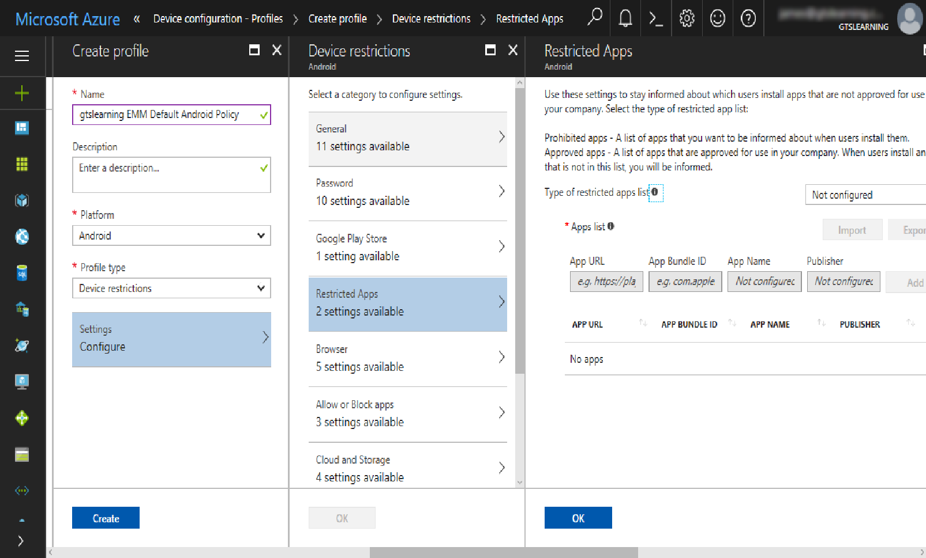
Application Management
MDM or EMM application uses policies to provide better management of a device.
Android allows third- party app stores to install untrusted application into a device with the user’s consent which is known as sideloading.

Slide 255
Content Management
Devices are usually privately owned for corporate use. Use for any other tasks creates data ownership and privacy issues.
Containerization sets up a corporate workspace segmented from the
employee’s private apps and data.
Container enforces storage segmentation to ensure separation of data.
Containerization also helps enforcing content management or DLP policies.

Slide 256
Rooting and Jailbreaking
Rooting or jailbreaking mobile devices involves subverting the security measures on
the device. This poses risk for enterprise management agent.
Rooting
Jailbreaking
Carrier Unlocking
Usually done in iOS and accomplished by restarting the device with a Patched kernel
Uses tethered jailbreak
Usually done in Android
Also known as custom firmware or ROM
Usually done in both iOS and Android
Unlocks a device to a
single carrier

Slide 257
Implement Secure Mobile Device Connections

Slide 258

Cellular and GPS Connection Methods
Mobile devices use a few connection methods to establish communication.
These methods:
Disable cellular data if unmonitored or unfiltered connection is detected
Help in preventing use for data exfiltration
Attack cellular connections in case in exploit is detected
Provide Global Positioning System (GPS)

Slide 259
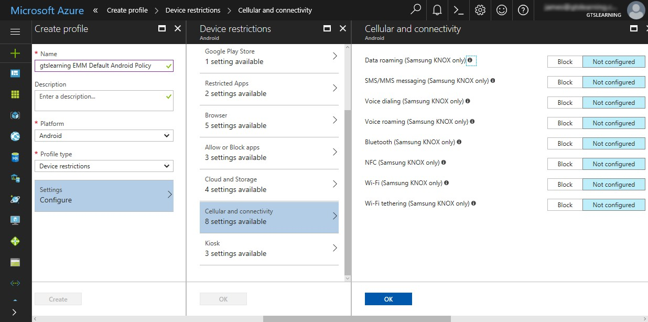
Cellular and GPS Connection Methods
Locking down Android connectivity methods with Intune.

Slide 260
Wi-Fi and Tethering Connection Methods
The risks from Wi-Fi are born from these access points:
Legacy security methods
Open access
points
Rogue access points

Slide 261
Wi-Fi and Tethering Connection Methods
The different types of Wi-Fi and tethering connections are:
Personal Area Network
(PAN) technologies
Wi-Fi Direct
Tethering and hotspots
Also called as Ad hoc networks
Functions as soft access point
Helps set up peer-to- peer network
Helps to connect mobile devices and other peripherals
Shares internet connection from one device to another device

Slide 262
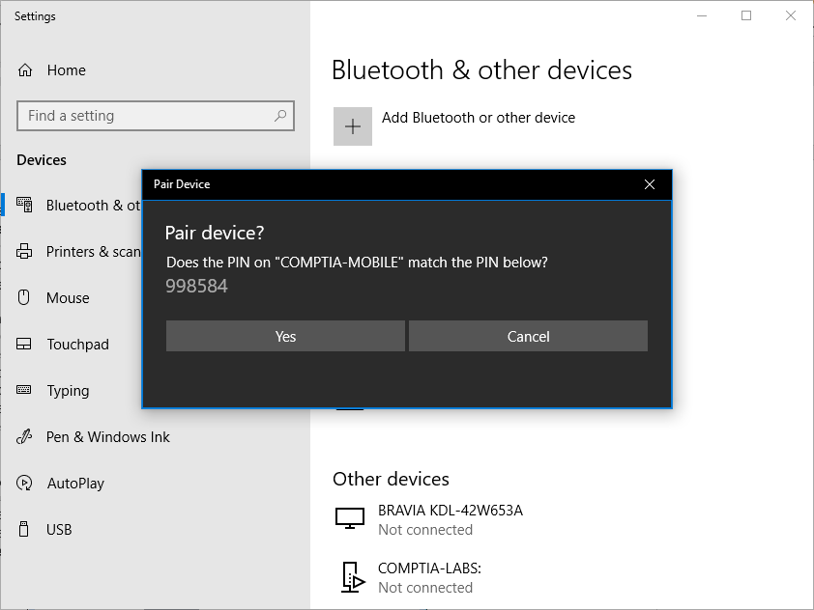
Bluetooth Connection Methods
Nearby devices can be connected by switching the Bluetooth on and making the device discoverable.

Slide 263



Bluetooth Connection Methods
Security issues in Bluetooth devices include:
Device Discovery
Authentication and authorization that includes pairing mechanism
Malware and exploits

Slide 264
Bluetooth Connection Methods
The different malware and exploits include:
Rogue firmware peripheral devices
Bluebourne
Bluejacking
Bluesnarfing

Slide 265

Infrared and RFID Connection Methods
Use of infrared in modern smartphones and wearable technology focuses on these two uses:
IR blaster
1
2
IR sensor

Slide 266
Infrared and RFID Connection Methods
Features and uses of Radio Frequency ID (RFID) are:
They are usually unpowered tags.
They transmit when the range is sufficient to reach the reader.
They are mostly used to encrypt sensitive information.
They are used to read signals from contactless bank card through skimming attack.

Slide 267

Near Field Communications and Mobile Payment Services
NFC is based on a particular type of Radio Frequency ID (RFID).
An NFC transaction is also known as bump, which is redeveloped as Android Beam to make it useful in NFC.
Mobile wallet apps enable a user or enterprise to transfer money digitally
from their bank accounts to another user’s or enterprise’s bank account .
Eavesdropping or skimming is a common problem which enables the attacker to eavesdrop the signals emitted by NFC from a safe distance.
The attacker can also corrupt the data by making use of DoS (Denial of
Service).

Slide 268

USB Connection Methods
USB OTG allows a port to function as a device or hub.
USB with malicious firmware might be able to perform an exploit. These USB devices:
Spread malware between computers using the device as a vector
Install or run malware to compromise the smartphone itself
Can also act as Trojan through juice-jacking

Slide 269




SMS, MMS, RCS, and Push Notifications
USB OTG allows a port to function as a device or hub.
Short Message Service (SMS): It is operated by cellular network
providers. It exploits again 2 – step verification mechanisms.
Multimedia Message Service (MMS): It is similar to SMS and allows text messages and binary files.
Rich Communication Services (RCS): It is designed as platform- independent advanced messaging app. It exploits against handling of attachments or rich formatting.
Push Notification: It has potential vector for spamming, phishing, or
hoaxing and ensures that developer account credentials are kept secure.

Slide 270
Firmware Over-the-Air Updates
A baseband update modifies the firmware of the radio modem used for
cellular, Wi-Fi, Bluetooth, NFC, and GPS connectivity.
The baseband updates can be delivered using a Wi-Fi or data connection which is also known as Over-The-Air (OTA) .
There are also several risk while delivering the update, such as:
Risks from rooted or jailbroken devices
Risks from highly targeted attacks

Slide 271
Microwave Radio Connection Methods
Microwave radio connection is also used as backhaul link from cell tower to provider network.
Private microwave links are also used between sites. A microwave link can be provisioned in two modes:
Point-to-Point (P2P) microwave
Uses high gain directional antenna to link two sites.
Point-to-Multipoint (P2M) microwave
Has smaller sectoral antennas.
Links multiple sites or mobile subscribers to a single hub.
Other types of multipoint
Multipoint can also used in other contexts. For example, Bluetooth. It supports a
multipoint mode.

Slide 272
Key Takeaways
Enterprise Mobility Management (EMM) applies security policies to use mobile devices and applications in the enterprise.
Remote wipe or kill switch is initiated from the enterprise management software. It sets the device to factory defaults or clears storage in case the smartphone gets stolen.
GPS tagging refers to the process of including the
geographical identification metadata in a device.
Microwave radio connection is also used as backhaul link from cell tower to provider network.

